Slide 1
Reliquary

Slide 2
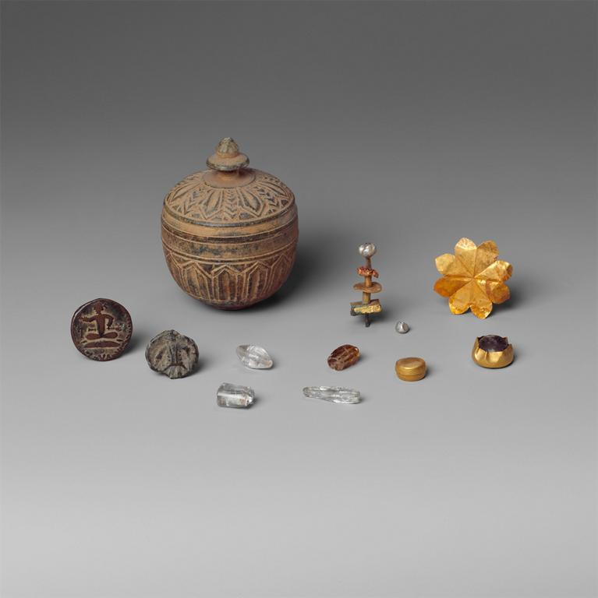
Notes:
Culture: Pakistan (ancient region of Gandhara) Title: Reliquary with Contents Period: Kushan period Date: ca. 1st century Location: : Pakistan (ancient region of Gandhara), Material: Schist with objects of copper, gold, rock crystal, and pearl objects Measurements: H. 2 9/16 in. (6.5 cm); Diam. 2 in. (5.1 cm) Repository: The Metropolitan Museum of Art Repository: http://www.metmuseum.org Collection: Metropolitan Museum of Art - Images for Academic Publishing ID Number: 5059 Source: Data From: The Metropolitan Museum of Art Credit Line: The Metropolitan Museum of Art, Gift of Mr. and Mrs. Uzi Zucker, 1987 (1987.258.2a-q) Image Copyright Notice: Image © The Metropolitan Museum of Art Rights: This image was provided by The Metropolitan Museum of Art. Contact information: Image Library, The Metropolitan Museum of Art, 1000 Fifth Avenue, New York, NY 10028, (212) 396-5050 (fax), Scholars.License@MetMuseum.org Rights: Image © The Metropolitan Museum of Art Rights: This image is available for uses permitted under the ARTstor Terms and Conditions of Use, such as teaching and study, as well as for scholarly publications, through the Images for Academic Publishing (IAP) initiative. If you are seeking to use this image for scholarly publication, you should click on the IAP icon below the thumbnail image.

Slide 3
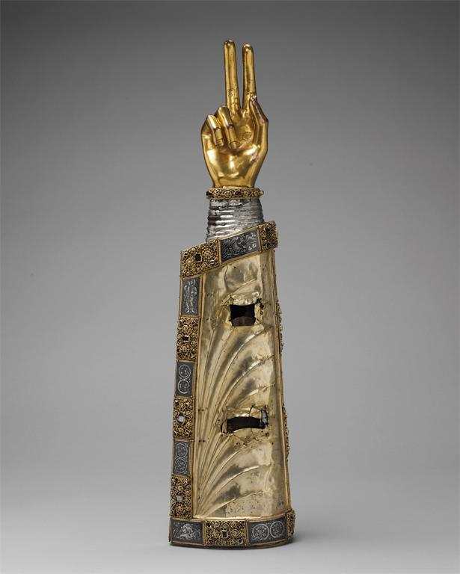
Notes:
Culture: German Title: Reliquary Arm Date: ca. 1230 Location: Made in: , Lorraine Material: Silver over oak; hand: bronze gilt; appliqué plaques: silver-gilt, niello and cabochon stones Measurements: 25 1/2 x 6 1/2 x 4 in. (64.8 x 16.5 x 10.2 cm) Repository: The Metropolitan Museum of Art Repository: http://www.metmuseum.org Collection: Metropolitan Museum of Art - Images for Academic Publishing ID Number: 11795 Source: Data From: The Metropolitan Museum of Art Credit Line: The Metropolitan Museum of Art, The Cloisters Collection, 1947 (47.101.33) Image Copyright Notice: Image © The Metropolitan Museum of Art Rights: This image was provided by The Metropolitan Museum of Art. Contact information: Image Library, The Metropolitan Museum of Art, 1000 Fifth Avenue, New York, NY 10028, (212) 396-5050 (fax), Scholars.License@MetMuseum.org Rights: Image © The Metropolitan Museum of Art Rights: This image is available for uses permitted under the ARTstor Terms and Conditions of Use, such as teaching and study, as well as for scholarly publications, through the Images for Academic Publishing (IAP) initiative. If you are seeking to use this image for scholarly publication, you should click on the IAP icon below the thumbnail image.

Slide 4
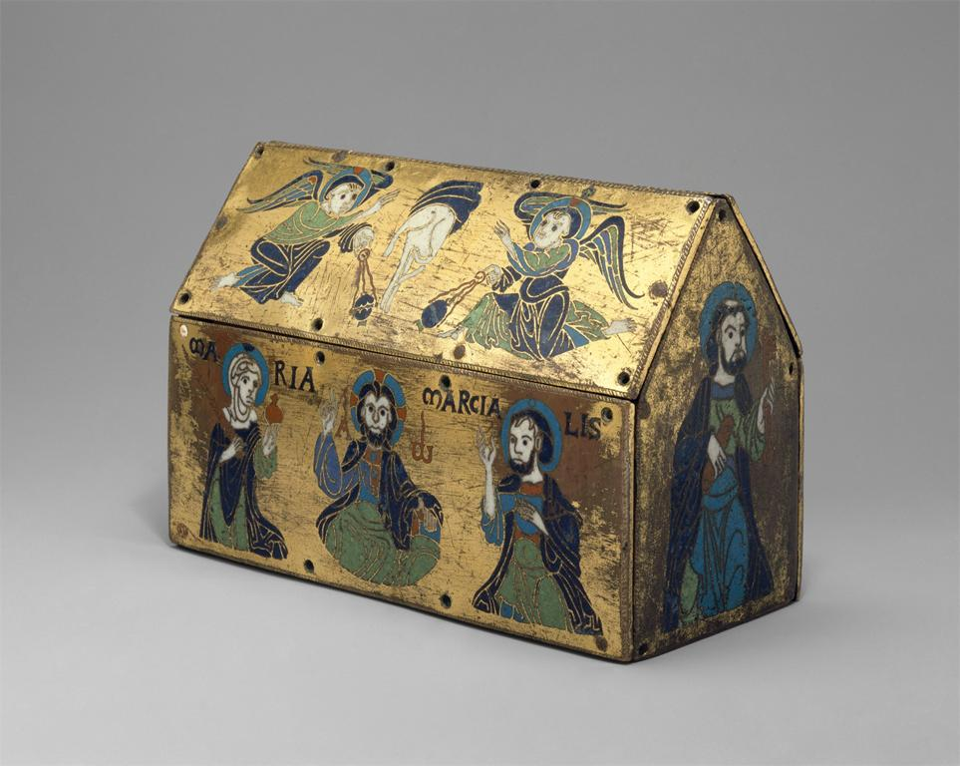
Notes:
Culture: French Title: Chasse of Champagnat Date: ca. 1150 Location: Made in: , Limoges Material: Copper: engraved and gilt; champlevé enamel: blue-black, medium blue, turquoise, green, red, and white Measurements: Overall: 4 7/8 x 7 7/16 x 3 3/8in. (12.4 x 18.9 x 8.5cm) Plaque: 2 3/4 x 7 7/16 x 1/16 in. (7 x 18.9 x 0.2 cm) Description: [principal face] : MARIA/MARCIALIS (Saint Martial) /A / W (Alpha / omega) Repository: The Metropolitan Museum of Art Repository: http://www.metmuseum.org Collection: Metropolitan Museum of Art - Images for Academic Publishing ID Number: 4446 Source: Data From: The Metropolitan Museum of Art Credit Line: The Metropolitan Museum of Art, Gift of J. Pierpont Morgan, 1917 (17.190.685) Image Copyright Notice: Image © The Metropolitan Museum of Art Rights: This image was provided by The Metropolitan Museum of Art. Contact information: Image Library, The Metropolitan Museum of Art, 1000 Fifth Avenue, New York, NY 10028, (212) 396-5050 (fax), Scholars.License@MetMuseum.org Rights: Image © The Metropolitan Museum of Art Rights: This image is available for uses permitted under the ARTstor Terms and Conditions of Use, such as teaching and study, as well as for scholarly publications, through the Images for Academic Publishing (IAP) initiative. If you are seeking to use this image for scholarly publication, you should click on the IAP icon below the thumbnail image.

Slide 5
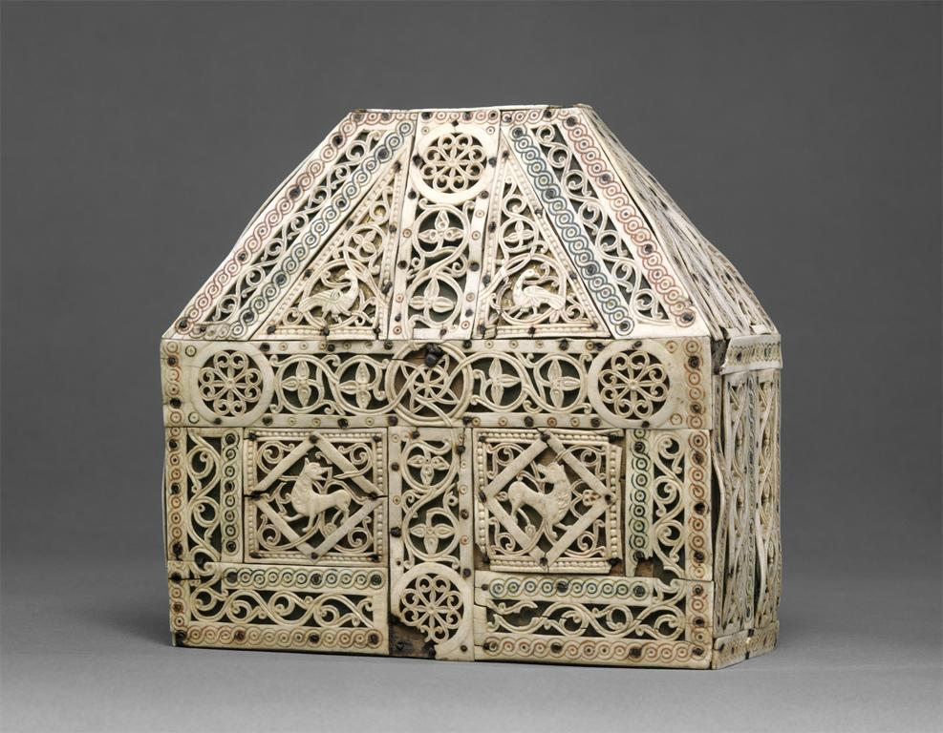
Notes:
Culture: North Italian Title: Bursa Reliquary Date: early 10th century Material: Bone, copper-gilt, wood Measurements: 7 3/4 x 7 5/16 x 3 1/4 in. (19.7 x 18.6 x 8.3 cm) Repository: The Metropolitan Museum of Art Repository: http://www.metmuseum.org Collection: Metropolitan Museum of Art - Images for Academic Publishing ID Number: 11994 Source: Data From: The Metropolitan Museum of Art Credit Line: The Metropolitan Museum of Art, The Cloisters Collection, 1953 (53.19.2) Image Copyright Notice: Image © The Metropolitan Museum of Art Rights: This image was provided by The Metropolitan Museum of Art. Contact information: Image Library, The Metropolitan Museum of Art, 1000 Fifth Avenue, New York, NY 10028, (212) 396-5050 (fax), Scholars.License@MetMuseum.org Rights: Image © The Metropolitan Museum of Art Rights: This image is available for uses permitted under the ARTstor Terms and Conditions of Use, such as teaching and study, as well as for scholarly publications, through the Images for Academic Publishing (IAP) initiative. If you are seeking to use this image for scholarly publication, you should click on the IAP icon below the thumbnail image.

Slide 6
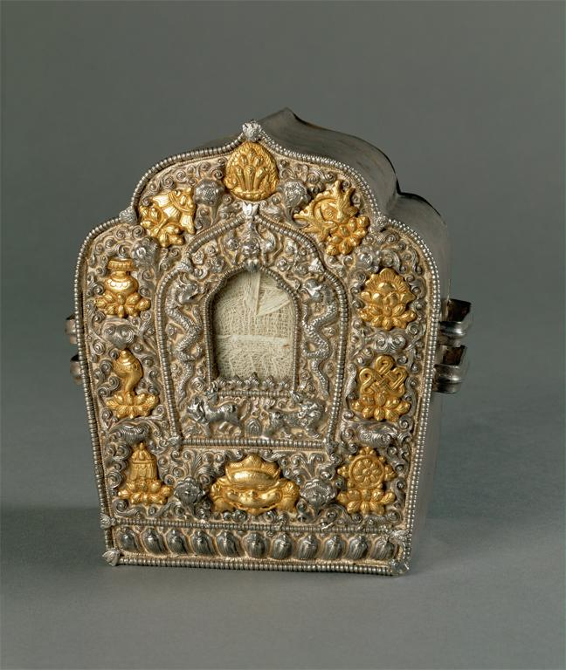
Notes:
Title: Reliquary with the eight auspicious symbols Work Type: reliquary Date: 18th cent. Material: silver, fire-gilding, copper back Measurements: 17 cm (height) Description: Used as a portable altar, or as a shrine on an altar for a specially precious relic Repository: National Museum of Bhutan Collection: Art, Archaeology, and Architecture (Erich Lessing Culture and Fine Arts Archives) ID Number: 04-01-03/24 Source: Image and original data provided by Erich Lessing Culture and Fine Arts Archives/ART RESOURCE, N.Y. Source: http://www.artres.com/c/htm/Home.aspx Source: http://www.artres.com/c/htm/TreePfLight.aspx?ID=LES Rights: Photo Credit: Erich Lessing/ART RESOURCE, N.Y. Rights: Please note that if this image is under copyright, you may need to contact one or more copyright owners for any use that is not permitted under the ARTstor Terms and Conditions of Use or not otherwise permitted by law. While ARTstor tries to update contact information, it cannot guarantee that such information is always accurate. Determining whether those permissions are necessary, and obtaining such permissions, is your sole responsibility.

Slide 7
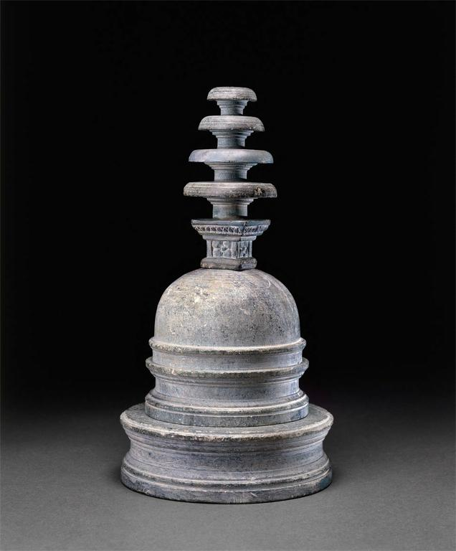
Notes:
Title: Reliquary in the form of a model stupa Work Type: ceremonial vessel Date: 1st-2nd cent. Description: The reliquary is in three parts. The drum of the stupa has an ovoid cavity that opens into the circular hollow base. The harmika (the short square railing surmounting the dome of the stupa) and chhatravali (the multiple parasols rising from the middle) form another piece. The exterior of the whole reliquary has been turned and bears several registers of moldings. Votive stupas were crafted to look just like the large architectural ones, and as containers of relic containers, they performed the same symbolic function. A rock crystal container was found inside the cavity in the dome. Repository: British Museum Accession Number: OA, 1887.7-17.34 Collection: Art, Archaeology, and Architecture (Erich Lessing Culture and Fine Arts Archives) ID Number: 03-07-02/27 Source: Image and original data provided by Erich Lessing Culture and Fine Arts Archives/ART RESOURCE, N.Y. Source: http://www.artres.com/c/htm/Home.aspx Source: http://www.artres.com/c/htm/TreePfLight.aspx?ID=LES Rights: Photo Credit: Erich Lessing/ART RESOURCE, N.Y. Rights: Please note that if this image is under copyright, you may need to contact one or more copyright owners for any use that is not permitted under the ARTstor Terms and Conditions of Use or not otherwise permitted by law. While ARTstor tries to update contact information, it cannot guarantee that such information is always accurate. Determining whether those permissions are necessary, and obtaining such permissions, is your sole responsibility.

Slide 8
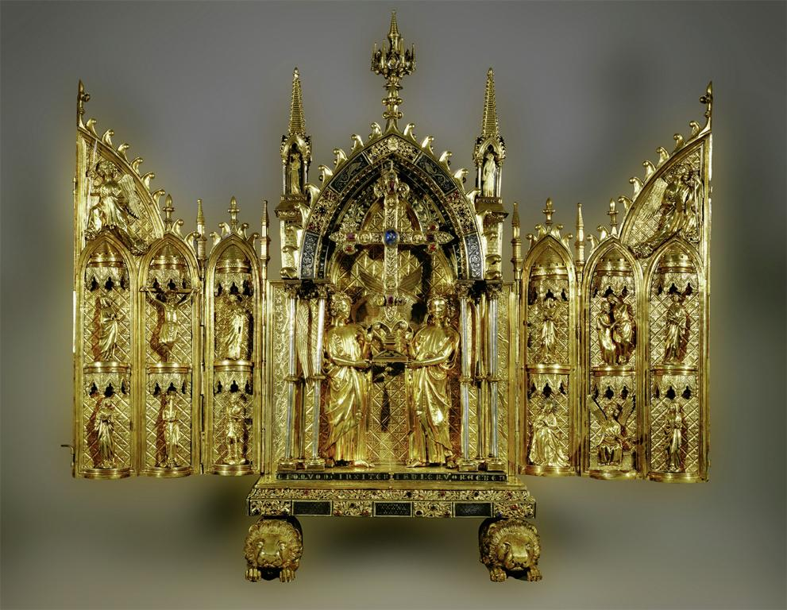
Notes:
Title: Triptych reliquary of the True Cross, open. Work Type: metalwork Date: after 1254 Material: gilded copper, silver niello, gems Measurements: open, 79 x 92 cm Description: From the Ile-de-France or northern France, Abbey of Floreffe. Repository: Musée du Louvre, inv. OA 5552. Collection: Art, Archaeology and Architecture (Erich Lessing Culture and Fine Arts Archives) ID Number: 15-01-04/14 Source: Image and original data provided by Erich Lessing Culture and Fine Arts Archives/ART RESOURCE, N.Y. Source: http://www.artres.com/c/htm/Home.aspx Source: http://www.artres.com/c/htm/TreePfLight.aspx?ID=LES Rights: Photo Credit: Erich Lessing/ART RESOURCE, N.Y. Rights: Please note that if this image is under copyright, you may need to contact one or more copyright owners for any use that is not permitted under the ARTstor Terms and Conditions of Use or not otherwise permitted by law. While ARTstor tries to update contact information, it cannot guarantee that such information is always accurate. Determining whether those permissions are necessary, and obtaining such permissions, is your sole responsibility.

Slide 9
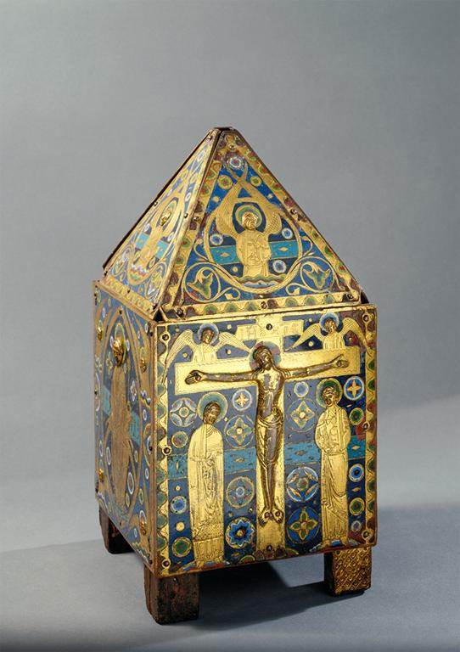
Notes:
Creator: Limoges Workshop Title: Reliquary châsse (or perhaps a Eucharistic tabernacle) Work Type: metalwork Date: mid 13th C Material: Champlevé enamel on copper gilt Measurements: shape: parallelepiped surmounted by a pyramid Style Period: Gothic Repository: Museo nazionale del Bargello (Florence, Italy) Collection: Italian and other European Art (Scala Archives) Source: Image and original data provided by SCALA, Florence/ART RESOURCE, N.Y. Source: http://www.artres.com/c/htm/Home.aspx Source: http://www.scalarchives.com Rights: (c) 2006, SCALA, Florence / ART RESOURCE, N.Y. Rights: Please note that if this image is under copyright, you may need to contact one or more copyright owners for any use that is not permitted under the ARTstor Terms and Conditions of Use or not otherwise permitted by law. While ARTstor tries to update contact information, it cannot guarantee that such information is always accurate. Determining whether those permissions are necessary, and obtaining such permissions, is your sole responsibility.

Slide 10
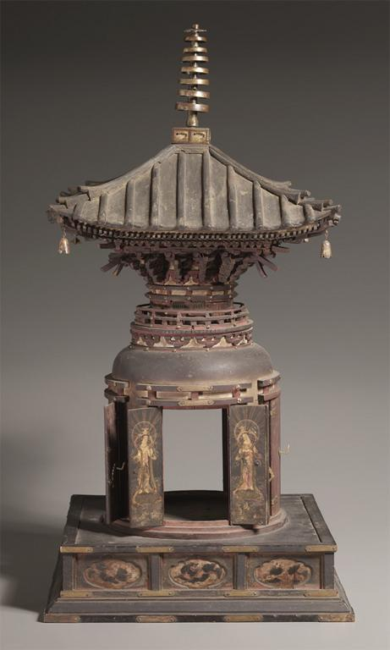
Notes:
Creator: Japan, Kamakura Period (1185-1333) Culture: Asian; Far East Asian; Japanese Title: Tahoto Reliquary Work Type: Sculpture Work Type: Sculpture Date: early to mid 14th century Material: wood and metal Measurements: Average: 68cm x 34.4cm Style Period: Japan, Kamakura Period (1185-1333) Description: Full View Repository: The Cleveland Museum of Art Repository: Cleveland, Ohio, USA Repository: John L. Severance Fund Repository: (Setsu Gatodo Company, Ltd.) Repository: 1982.8 Repository: http://www.clemusart.com/ Collection: The Cleveland Museum of Art Collection Collection: Formerly in The AMICO Library ID Number: CMA_.1982.8 Source: Data from: The Cleveland Museum of Art Rights: This image was provided by The Cleveland Museum of Art. Contact information: Kathleen Kornell, Rights and Reproductions Coordinator, The Cleveland Museum of Art, 11150 East Blvd., Cleveland OH 44106, (216) 707-2498 (ph), (216) 421-8815 (fax), Kkornell@clevelandart.org. Rights: Please note that if this image is under copyright, you may need to contact one or more copyright owners for any use that is not permitted under the ARTstor Terms and Conditions of Use or not otherwise permitted by law. While ARTstor tries to update contact information, it cannot guarantee that such information is always accurate. Determining whether those permissions are necessary, and obtaining such permissions, is your sole responsibility.

Slide 11
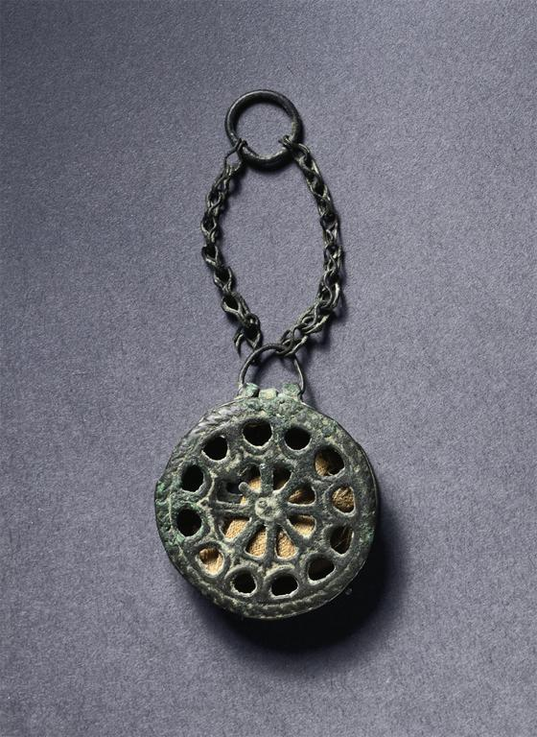
Notes:
Creator: Egypt(?) or Syria(?), Early Byzantine Culture: Asian; Anatolian; Byzantine Title: Phylactery (Reliquary Penant) Work Type: Decorative Arts and Utilitarian Objects Work Type: Metalwork Date: c. 500-700 Material: copper alloy Measurements: Diameter: 3.2cm, Overall: Description: Full View Repository: The Cleveland Museum of Art Repository: Cleveland, Ohio, USA Repository: Gift of Bruce Ferrini in memory of Robert P. Bergman Repository: 1999.237 Repository: http://www.clemusart.com/ Collection: The Cleveland Museum of Art Collection Collection: Formerly in The AMICO Library ID Number: CMA_.1999.237 Source: Data from: The Cleveland Museum of Art Rights: This image was provided by The Cleveland Museum of Art. Contact information: Kathleen Kornell, Rights and Reproductions Coordinator, The Cleveland Museum of Art, 11150 East Blvd., Cleveland OH 44106, (216) 707-2498 (ph), (216) 421-8815 (fax), Kkornell@clevelandart.org. Rights: Please note that if this image is under copyright, you may need to contact one or more copyright owners for any use that is not permitted under the ARTstor Terms and Conditions of Use or not otherwise permitted by law. While ARTstor tries to update contact information, it cannot guarantee that such information is always accurate. Determining whether those permissions are necessary, and obtaining such permissions, is your sole responsibility.

Slide 12
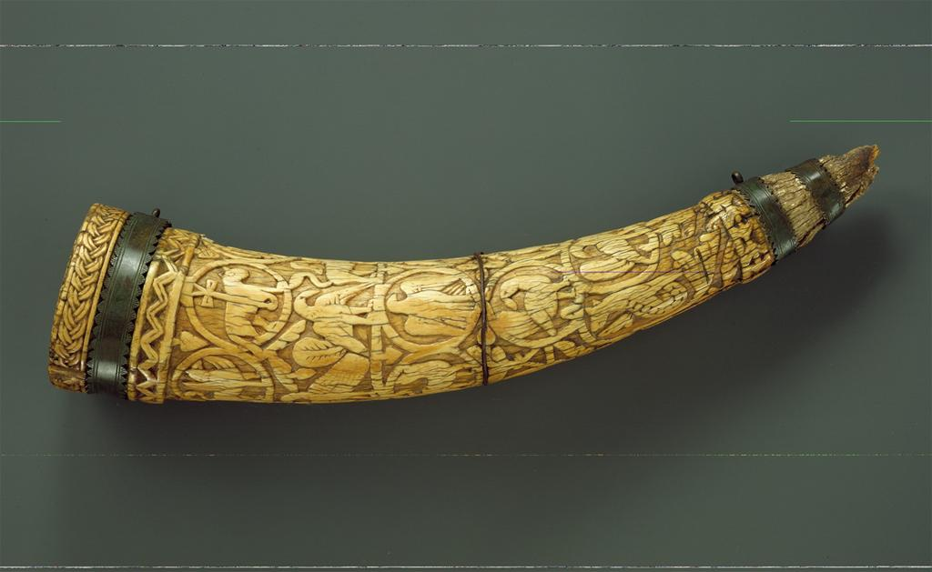
Notes:
Creator: South Italian Culture: European; Southern European; Italian Title: Horn Work Type: Decorative Arts and Utilitarian Objects Date: ca. 1100-1200 Material: Ivory Measurements: 17 x 3 1/2 in. (43.2 x 8.9 cm) Description: Large decorated elephant tusks were used for both religious and secular purposes. They could be employed as drinking vessels, as horns to announce the hunt, or as symbols of feudal rights. Many were given to churches, and some served as reliquary containers. This example shows Christ as the Lamb of God. Description: Principal view Repository: The Metropolitan Museum of Art Repository: New York, New York Repository: Gift of J. Pierpont Morgan, 1917 Repository: 17.190.218 Repository: http://www.metmuseum.org Collection: The Metropolitan Museum of Art Collection Collection: Formerly in The AMICO Library ID Number: MMA_.17.190.218 Source: Data From: The Metropolitan Museum of Art Rights: This image was provided by The Metropolitan Museum of Art. Contact information: Photograph and Slide Library, The Metropolitan Museum of Art, 1000 Fifth Avenue, New York, NY 10028, (212) 396-5050 (fax). Rights: Please note that if this image is under copyright, you may need to contact one or more copyright owners for any use that is not permitted under the ARTstor Terms and Conditions of Use or not otherwise permitted by law. While ARTstor tries to update contact information, it cannot guarantee that such information is always accurate. Determining whether those permissions are necessary, and obtaining such permissions, is your sole responsibility.

Slide 13
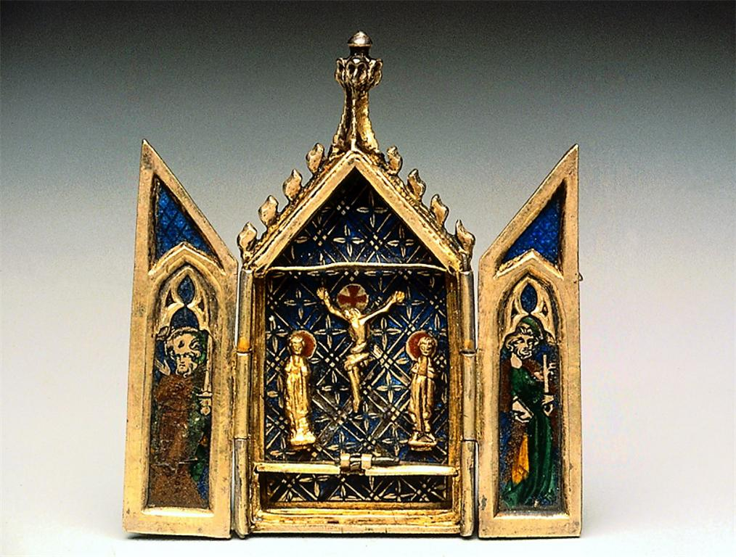
Notes:
Title: Reliquary Triptych with the Crucifixion, Coronation of the Virgin, Saint Peter and Saint Paul Work Type: Decorative Arts and Utilitarian Objects Date: early 14th century Material: Bass-taille and champlevé enamel and gilding on silver Measurements: 6.9 x 6.2 cm (2 11/16 x 2 7/16 in.) Description: Paris or England Description: Full View Repository: Museum of Fine Arts, Boston Repository: Boston, Massachusetts, USA Repository: Theodora Wilbour Fund in memory of Charlotte Beebe Wilbour (1833-1914) Repository: 58.354 Repository: http://www.mfa.org/ Collection: Museum of Fine Arts, Boston, Collection Collection: Formerly in The AMICO Library ID Number: BMFA.58.354 Source: Data From: Museum of Fine Arts, Boston Rights: This image was provided by Museum of Fine Arts, Boston. Contact information: Debra LaKind, Head of Rights & Licensing, Museum of Fine Arts, Boston, 465 Huntington Avenue, Boston, MA 02115, (617) 369-4386 (ph), (617) 369-4340 (fax), dlakind@mfa.org. Rights: Please note that if this image is under copyright, you may need to contact one or more copyright owners for any use that is not permitted under the ARTstor Terms and Conditions of Use or not otherwise permitted by law. While ARTstor tries to update contact information, it cannot guarantee that such information is always accurate. Determining whether those permissions are necessary, and obtaining such permissions, is your sole responsibility.

Slide 14
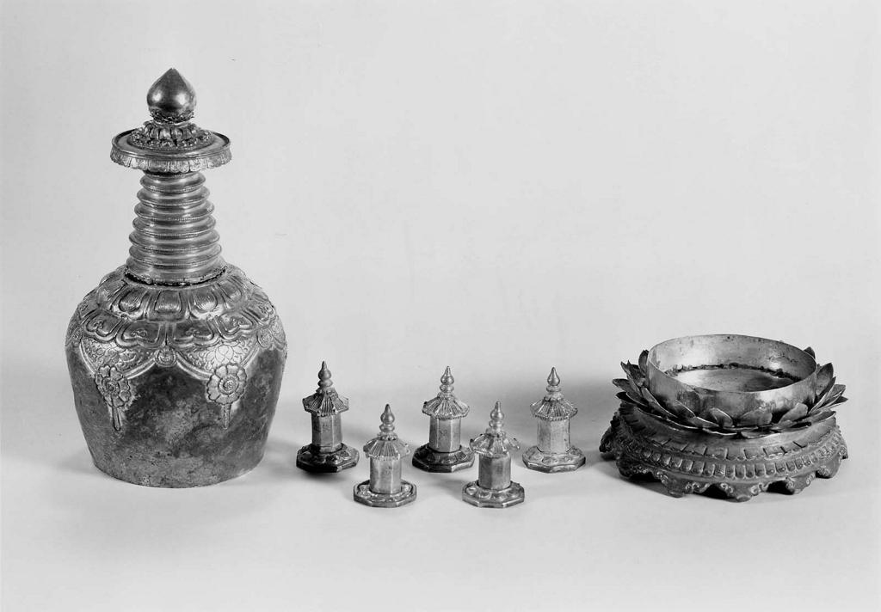
Notes:
Title: Reliquary in the shape of a stupa Work Type: Decorative Arts and Utilitarian Objects Date: about 1464 Material: Silver; parcel gilt and repousse decoration Measurements: H x D: 22.5 x 11.9 cm (8 7/8 x 4 11/16 in.) Description: Korea Description: Full View Repository: Museum of Fine Arts, Boston Repository: Boston, Massachusetts, USA Repository: Charles Goddard Weld Collection, by exchange Repository: 39.591a Repository: http://www.mfa.org/ Collection: Museum of Fine Arts, Boston, Collection Collection: Formerly in The AMICO Library ID Number: BMFA.39.591a Source: Data From: Museum of Fine Arts, Boston Rights: This image was provided by Museum of Fine Arts, Boston. Contact information: Debra LaKind, Head of Rights & Licensing, Museum of Fine Arts, Boston, 465 Huntington Avenue, Boston, MA 02115, (617) 369-4386 (ph), (617) 369-4340 (fax), dlakind@mfa.org. Rights: Please note that if this image is under copyright, you may need to contact one or more copyright owners for any use that is not permitted under the ARTstor Terms and Conditions of Use or not otherwise permitted by law. While ARTstor tries to update contact information, it cannot guarantee that such information is always accurate. Determining whether those permissions are necessary, and obtaining such permissions, is your sole responsibility.

Slide 15
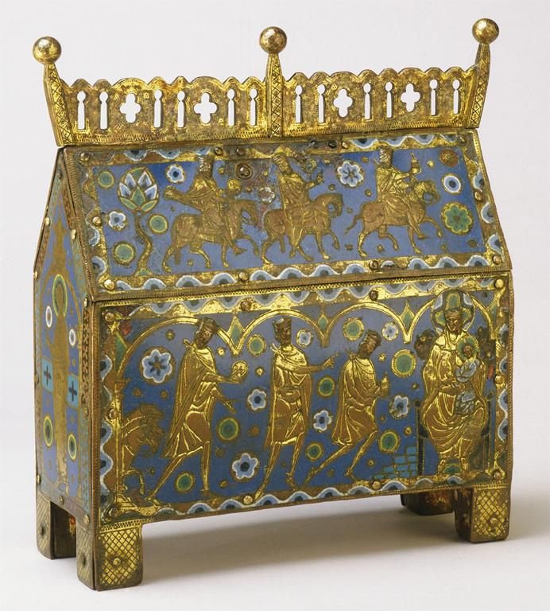
Notes:
Creator: Artist/maker unknown, French Title: Reliquary (Chasse) Work Type: Decorative Arts and Utilitarian Objects Work Type: Enamels Date: 1220-30 Location: Made in Limoges, France Material: Gilded copper alloy, champlevé enamel, painted wood, iron Measurements: 8 7/8 x 9 1/2 x 3 7/8 inches (22.5 x 24.1 x 9.8 cm) Description: Full View Repository: Philadelphia Museum of Art Repository: Philadelphia, Pennsylvania, USA Repository: Gift of Henry P. McIlhenny, 1950 Repository: 1950-31-1 Repository: http://www.philamuseum.org/main.asp Collection: Philadelphia Museum of Art Collection Collection: Formerly in The AMICO Library ID Number: PMA_.1950-31-1 Source: Data From: Philadelphia Museum of Art Rights: This image was provided by Philadelphia Museum of Art. Contact information: Ms. Conna Clark, Manager, Rights & Reproductions, Philadelphia Museum of Art, P.O. Box 7646, Philadelphia, PA 19101, (215) 684-7901 (ph), (215) 235-0034 (fax), cclark@philamuseum.org. Rights: Please note that if this image is under copyright, you may need to contact one or more copyright owners for any use that is not permitted under the ARTstor Terms and Conditions of Use or not otherwise permitted by law. While ARTstor tries to update contact information, it cannot guarantee that such information is always accurate. Determining whether those permissions are necessary, and obtaining such permissions, is your sole responsibility.

Slide 16
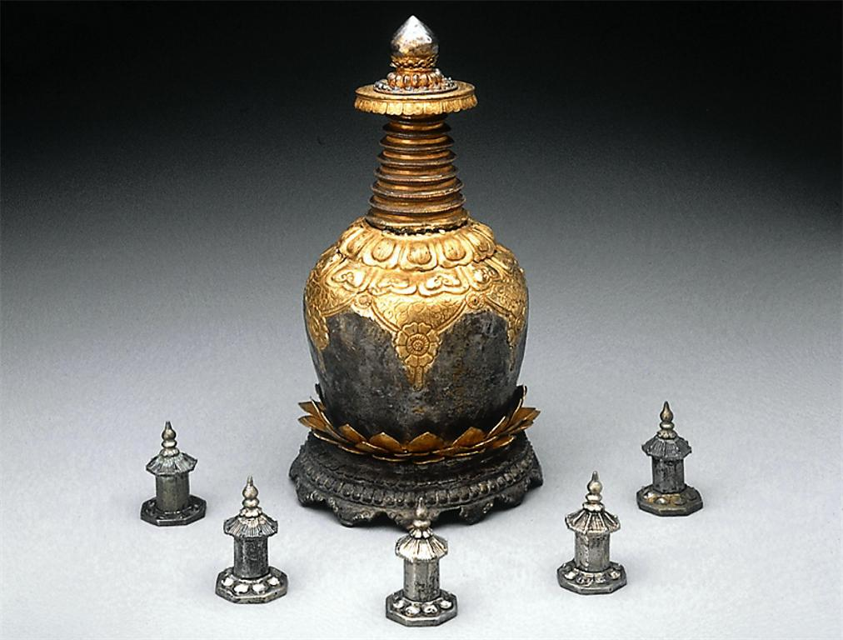
Notes:
Creator: unidentified artist/maker Title: Reliquary in the shape of a stupa Work Type: Decorative Arts and Utilitarian Objects Work Type: Decorative Arts Date: ca. 1464 A.D. Material: Silver; parcel gilt and repoussé decoration Measurements: H: 22.5 cm Style Period: Korea; Choson Dynasty Description: Full view Repository: Museum of Fine Arts, Boston Repository: Boston, Massachusetts, USA Repository: Charles Goddard Wells Collection Repository: 39.591 Repository: http://www.mfa.org/ Collection: Museum of Fine Arts, Boston, Collection Collection: Formerly in The AMICO Library ID Number: BMFA.39.591 Source: Data From: Museum of Fine Arts, Boston Rights: This image was provided by Museum of Fine Arts, Boston. Contact information: Debra LaKind, Head of Rights & Licensing, Museum of Fine Arts, Boston, 465 Huntington Avenue, Boston, MA 02115, (617) 369-4386 (ph), (617) 369-4340 (fax), dlakind@mfa.org. Rights: Please note that if this image is under copyright, you may need to contact one or more copyright owners for any use that is not permitted under the ARTstor Terms and Conditions of Use or not otherwise permitted by law. While ARTstor tries to update contact information, it cannot guarantee that such information is always accurate. Determining whether those permissions are necessary, and obtaining such permissions, is your sole responsibility.

Slide 17
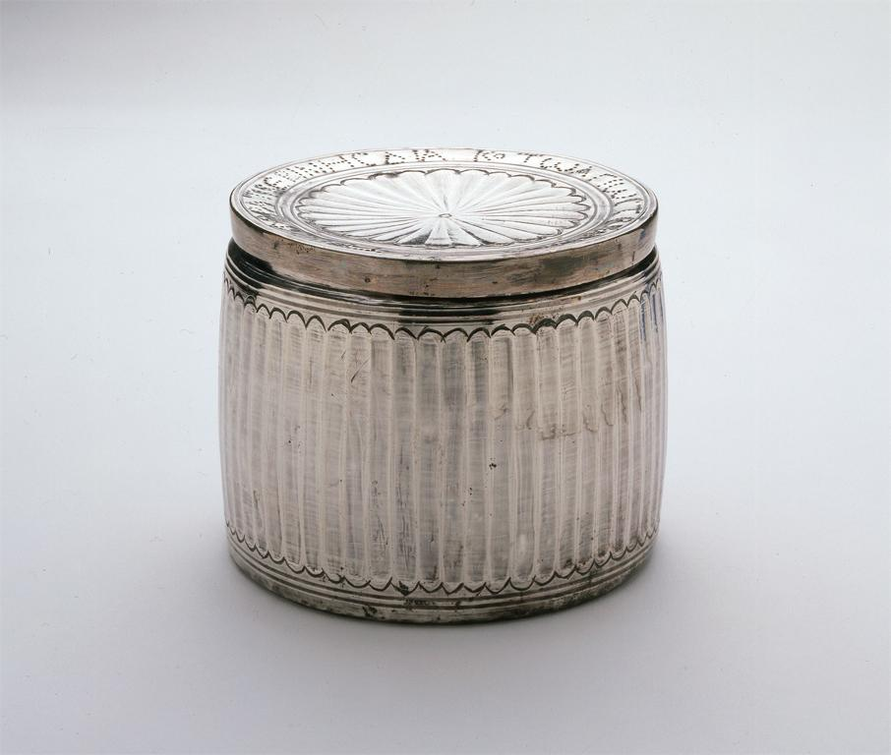
Notes:
Creator: Byzantine Title: Reliquary with Inscription Work Type: metalwork Date: 6th7th century Location: Place of origin: Syria Material: silver Measurements: 3 7/16 x 4 5/16 in. (8.7 x 11 cm) Repository: Saint Louis Art Museum, Museum Purchase Accession Number: 44:1924 Collection: Saint Louis Art Museum Source: Image and original data provided by Saint Louis Art Museum Source: http://www.slam.org/ Rights: Contact Information: Saint Louis Art Museum, One Fine Arts Drive, Forest Park, St. Louis, Missouri 63110; image.request@slam.org Rights: Please note that if this image is under copyright, you may need to contact one or more copyright owners for any use that is not permitted under the ARTstor Terms and Conditions of Use or not otherwise permitted by law. While ARTstor tries to update contact information, it cannot guarantee that such information is always accurate. Determining whether those permissions are necessary, and obtaining such permissions, is your sole responsibility.

Slide 18
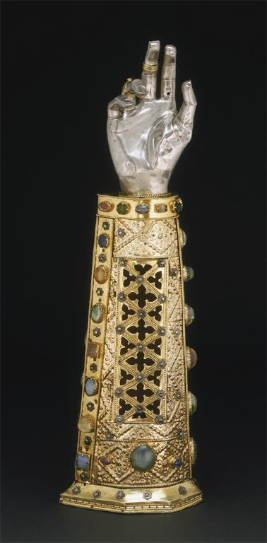
Notes:
Creator: Artist/maker unknown, German Title: Arm Reliquary of Saint Babylas Work Type: Decorative Arts and Utilitarian Objects Work Type: Metalwork Date: 1467 Location: Made in Brunswick, Germany Material: Silver, gilded silver, enamel, glass paste stones, rock crystals, and one amethyst on an oak core Measurements: Height 18 5/8 inches (47.3 cm) Description: Front Repository: Philadelphia Museum of Art Repository: Philadelphia, Pennsylvania, USA Repository: Purchased with Museum funds, 1951 Repository: 1951-12-1 Repository: http://www.philamuseum.org/main.asp Collection: Philadelphia Museum of Art Collection Collection: Formerly in The AMICO Library ID Number: PMA_.1951-12-1 Source: Data From: Philadelphia Museum of Art Rights: This image was provided by Philadelphia Museum of Art. Contact information: Ms. Conna Clark, Manager, Rights & Reproductions, Philadelphia Museum of Art, P.O. Box 7646, Philadelphia, PA 19101, (215) 684-7901 (ph), (215) 235-0034 (fax), cclark@philamuseum.org. Rights: Please note that if this image is under copyright, you may need to contact one or more copyright owners for any use that is not permitted under the ARTstor Terms and Conditions of Use or not otherwise permitted by law. While ARTstor tries to update contact information, it cannot guarantee that such information is always accurate. Determining whether those permissions are necessary, and obtaining such permissions, is your sole responsibility.

Slide 19
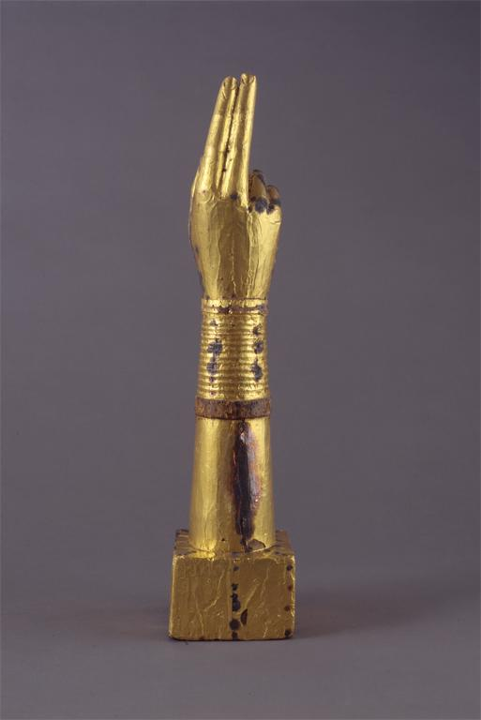
Notes:
Creator: French Title: Reliquary Arm Work Type: sculpture Date: c.10501100 Location: Place made: France Material: wood and sheet gold Measurements: 21 1/2 x 4 1/2 x 4 1/2 in. (54.6 x 11.4 x 11.4 cm) Repository: Saint Louis Art Museum, Museum Purchase Accession Number: 75:1949 Collection: Saint Louis Art Museum Source: Image and original data provided by Saint Louis Art Museum Source: http://www.slam.org/ Rights: Contact Information: Saint Louis Art Museum, One Fine Arts Drive, Forest Park, St. Louis, Missouri 63110; image.request@slam.org Rights: Please note that if this image is under copyright, you may need to contact one or more copyright owners for any use that is not permitted under the ARTstor Terms and Conditions of Use or not otherwise permitted by law. While ARTstor tries to update contact information, it cannot guarantee that such information is always accurate. Determining whether those permissions are necessary, and obtaining such permissions, is your sole responsibility.

Slide 20
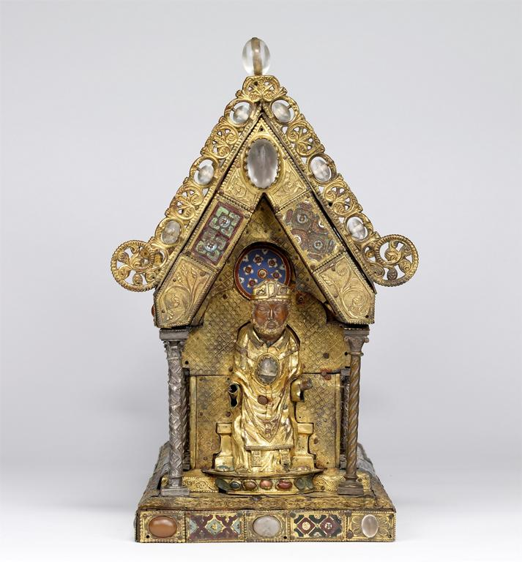
Notes:
Creator: Flemish Culture: European; Flemish Title: St. Amandus, Apostles, and Evangelists Work Type: Decorative Arts and Utilitarian Objects Work Type: reliquary shrine Date: 1250-1275 Material: copper gilt, silver, champlevé enamel, and semi-precious stones Measurements: 48.4 cm x 63.9 cm Repository: The Walters Art Museum Repository: Baltimore, Maryland, USA Repository: 53.9 Repository: Acquired by Henry Walters, 1930 Repository: http://www.thewalters.org/html/home.asp Collection: The Walters Art Museum Collection Collection: Formerly in The AMICO Library ID Number: TWAM.53.9 Source: Data From: The Walters Art Museum Rights: This image was provided by The Walters Art Museum. Contact information: Lauren Simonutti, Photo Services Coordinator, The Walters Art Museum, 600 North Charles Street, Baltimore, MD 21201, (410) 547-9000 x254 (ph), (410) 752-4797 (fax), lsimonutti@thewalters.org. Rights: Please note that if this image is under copyright, you may need to contact one or more copyright owners for any use that is not permitted under the ARTstor Terms and Conditions of Use or not otherwise permitted by law. While ARTstor tries to update contact information, it cannot guarantee that such information is always accurate. Determining whether those permissions are necessary, and obtaining such permissions, is your sole responsibility.

Slide 21
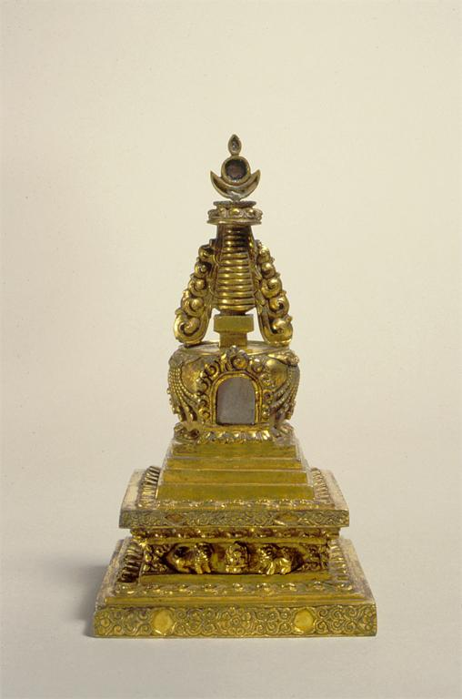
Notes:
Creator: Sino-Tibetan Title: Reliquary in the Form of a Stupa Work Type: sculpture Date: 18th century Location: Place of origin: China Material: bronze with gilding and inlay Measurements: 6 3/8 x 3 9/16 x 3 5/8 in. (16.2 x 9 x 9.2 cm) Repository: Saint Louis Art Museum, Gift of J. Lionberger Davis Accession Number: 570:1957 Collection: Saint Louis Art Museum Source: Image and original data provided by Saint Louis Art Museum Source: http://www.slam.org/ Rights: Contact Information: Saint Louis Art Museum, One Fine Arts Drive, Forest Park, St. Louis, Missouri 63110; image.request@slam.org Rights: Please note that if this image is under copyright, you may need to contact one or more copyright owners for any use that is not permitted under the ARTstor Terms and Conditions of Use or not otherwise permitted by law. While ARTstor tries to update contact information, it cannot guarantee that such information is always accurate. Determining whether those permissions are necessary, and obtaining such permissions, is your sole responsibility.

Slide 22
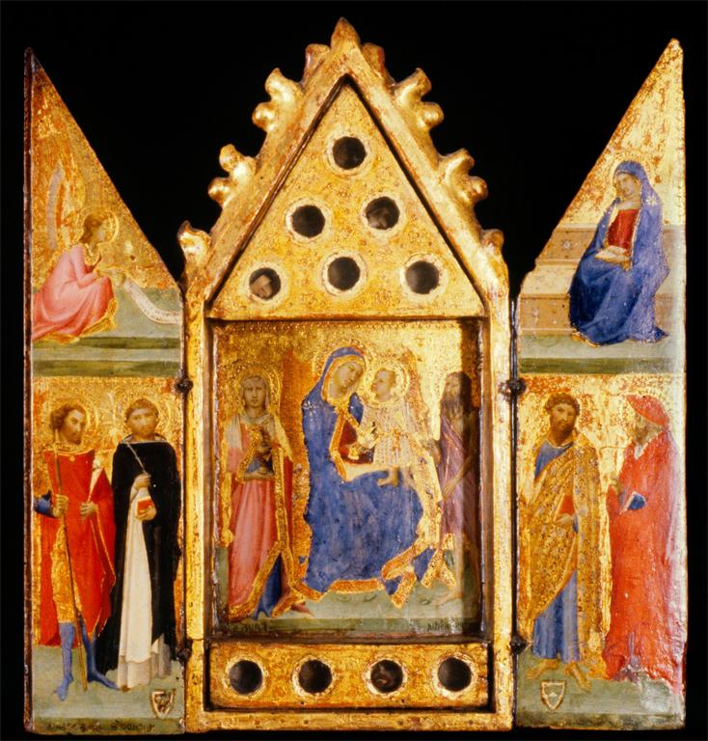
Notes:
Creator: Artist: Lippo Vanni, Italian, active 1344-1376 Title: Reliquary with Madonna and Child with Saints Work Type: reliquaries; triptychs; altarpieces Period: Medieval Date: 1350-1359 Location: Place of Origin: Siena, Italy Material: tempera and gold leaf on wood, paper, relics Measurements: open: 19 5/16 x 17 13/16 x 2 5/16 in. (49 x 45.3 x Style: Gothic Description: This triptych, or three-paneled altarpiece, once contained relics in the circular holes of the central section. Around the Madonna and Child in the places of honor are Saints Aurea and John the Baptist. On the wings, Gabriel announces the incarnation of Christ with the words written in Latin on his scroll which translate as, "the Holy Ghost shall come upon thee and the power of the Almighty shall overshadow thee," from the mass sung on the Feast of the Annunciation. The unidentified coats of arms are probably those of the donors. The delicacy of this work reveals Vanni's debt to Simone Martini. Description: [Transcription] On central panel, below left saint: S[AN]C[T]A AURA; [Translation] On central panel, below left saint: Saint Aurea; [Transcription] On central panel below right saint: S[AN]C[TU]S IOH[N]ES BATTI[ST]; [Translation] On central panel below right saint: Saint John the Baptist; [Transcription] On left wing under left saint in black paint: MAR... (?); [Transcription] On left wing under right saint in black paint: S DOMINI; S[ANCTUS] DOMINI[CUS]; [Translation] On left wing under right saint in black paint: Saint Dominic; [Transcription]: On left wing in upper register on scroll: SPI[RITUS SANCTUS] ET VENIET [IN TE] ET VIRTUS ALTIS[S]IMI OB[UMBRABIT TIBI]; [Translation] On left wing in upper register on scroll: the Holy Ghost shall come upon thee and the power of the Almighty shall overshadow thee Repository: The Walters Art Museum Repository: Acquired by Henry Walters with the Massarenti Collection, 1902 Repository: 37.75 Repository: Don Marcello Massarenti Collection, Rome, by purchase; Henry Walters, Baltimore, 1902, by purchase; Walters Art Museum, 1931, by bequest. Repository: http://thewalters.org Collection: The Walters Art Museum Rights: For information on reproductions for publishing or commercial use, Contact Photographic Services at 410-547-9000 ext. 254 or email photoservices@thewalters.org. Rights: Please note that if this image is under copyright, you may need to contact one or more copyright owners for any use that is not permitted under the ARTstor Terms and Conditions of Use or not otherwise permitted by law. While ARTstor tries to update contact information, it cannot guarantee that such information is always accurate. Determining whether those permissions are necessary, and obtaining such permissions, is your sole responsibility.

Slide 23
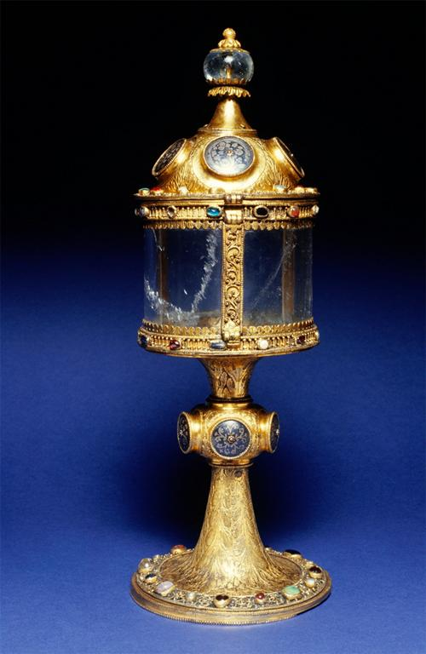
Notes:
Creator: Workshop: Mosan Workshop Culture: Mosan Title: Monstrance Work Type: monstrances Period: Medieval Date: ca. 1230 Location: Place of Origin: Belgium Material: copper with gilding, semi-precious stones, niello and rock crystal. Measurements: 14 x 5 1/16 in. (35.5 x 12.9 cm) (h. x diam.) Style: Gothic Description: The circular depression inside the rock crystal container of this monstrance (display reliquary) suggests that it was made for the display and veneration of the Host (communion wafer). This beautifully crafted example is a rare early example, as monstrances for the Host became popular only after the establishment in 1311 of the Feast of the Holy Sacrament (Corpus Christi), dedicated to the Host. Repository: The Walters Art Museum Repository: Acquired by Henry Walters Repository: 53.48 Repository: E. Bonnaffe, Paris; E. Bonnaffe Sale, Paris, May 3, 1897, no. 24; Henry Walters, Baltimore, [date of acquisition unknown] by purchase; Walters Art Museum, 1931, by bequest. Repository: http://thewalters.org Collection: The Walters Art Museum Rights: For information on reproductions for publishing or commercial use, Contact Photographic Services at 410-547-9000 ext. 254 or email photoservices@thewalters.org. Rights: Please note that if this image is under copyright, you may need to contact one or more copyright owners for any use that is not permitted under the ARTstor Terms and Conditions of Use or not otherwise permitted by law. While ARTstor tries to update contact information, it cannot guarantee that such information is always accurate. Determining whether those permissions are necessary, and obtaining such permissions, is your sole responsibility.

Slide 24
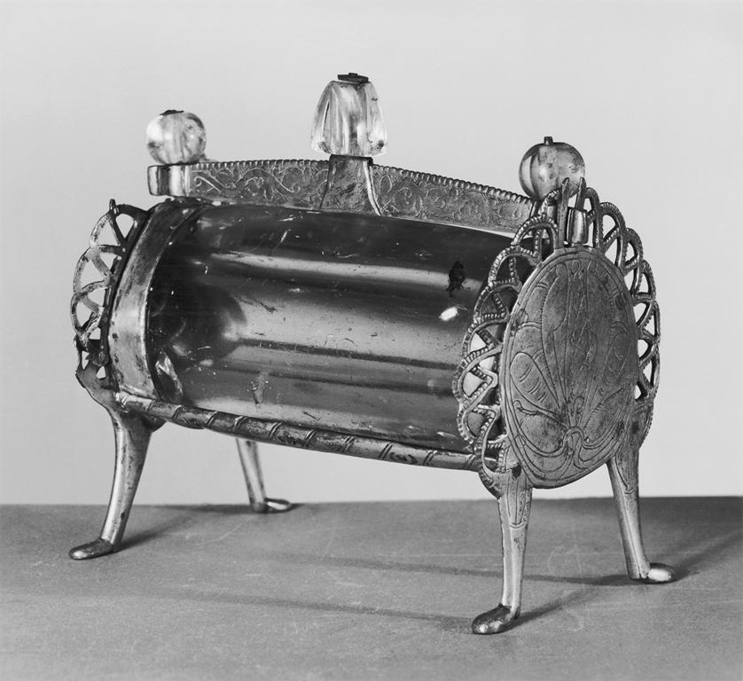
Notes:
Creator: Artist: Anonymous (Rhenish) Title: Crystal Reliquary Work Type: reliquaries Period: Medieval Date: ca. 1200 Location: Place of Origin: Germany Material: copper with gilding on rock crystal Measurements: 5 11/16 x 6 5/8 x 3 3/4 in. (14.5 x 16.8 x 9.5 cm) Style: Gothic Description: This barrel-shaped reliquary is formed of a large, cylindrical piece of crystal bored down the middle to create a narrow compartment for a relic. The rock crystal makes this a type of monstrance (display reliquary) that presents the relic for veneration visibly rather than keeping it hidden from view as in an enamel, church-shaped shrine. Repository: The Walters Art Museum Repository: Acquired by Henry Walters, 1929 Repository: 53.8 Repository: Tycon and Smith, Paris, by purchase; Henry Walters, Baltimore, 1929, by purchase; Walters Art museum, 1931, by bequest. Repository: http://thewalters.org Collection: The Walters Art Museum Rights: For information on reproductions for publishing or commercial use, Contact Photographic Services at 410-547-9000 ext. 254 or email photoservices@thewalters.org. Rights: Please note that if this image is under copyright, you may need to contact one or more copyright owners for any use that is not permitted under the ARTstor Terms and Conditions of Use or not otherwise permitted by law. While ARTstor tries to update contact information, it cannot guarantee that such information is always accurate. Determining whether those permissions are necessary, and obtaining such permissions, is your sole responsibility.

Slide 25
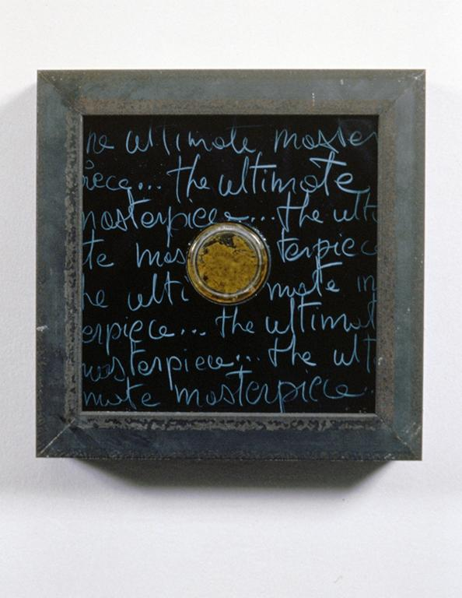
Notes:
Creator: Orlan Title: Reliquary #13: Ultimate Masterpiece Work Type: Sculpture and Installations Date: 1993 Location: Exhibited at Gering & López Gallery and Penine Hart Gallery, Winter 1995 Measurements: 10" x 10" x 2" Description: Photographer: Larry Qualls Collection: Contemporary Art (Larry Qualls Archive) Source: Image and original data provided by Larry Qualls Rights: © 2008 Artists Rights Society (ARS), New York / ADAGP, Paris

Slide 26
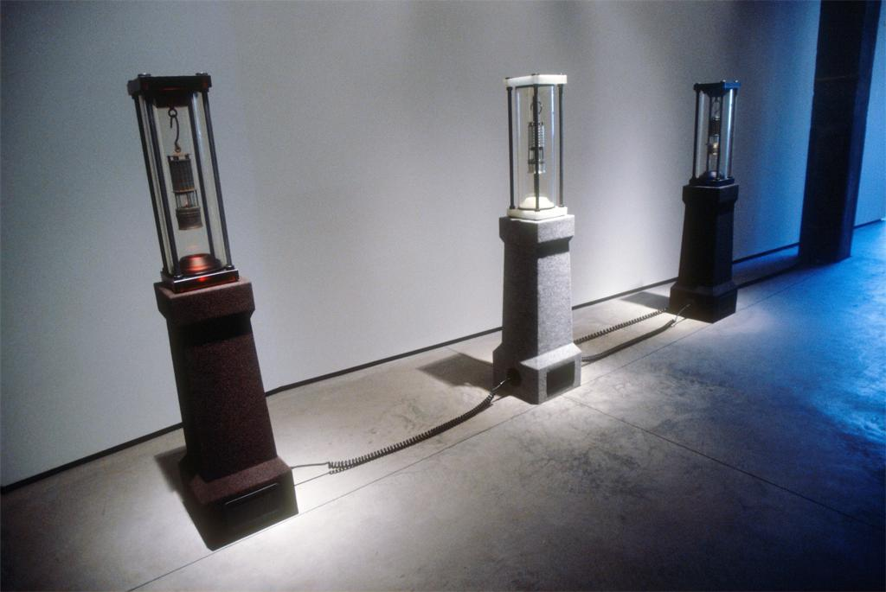
Notes:
Creator: Julian Laverdiere Title: Allied Uranium Miners Work Type: Sculpture and Installations Date: 2001 Location: Exhibited at Lehmann Maupin Gallery, Spring 2003 Material: Pitch Blend miners lantern encapsulated in reliquary on cenotaph Measurements: 3 parts, each 61 x 13 x 13 inches Description: Photographer: Larry Qualls Collection: Contemporary Art (Larry Qualls Archive) Source: Image and original data provided by Larry Qualls Rights: Please note that if this image is under copyright, you may need to contact one or more copyright owners for any use that is not permitted under the ARTstor Terms and Conditions of Use or not otherwise permitted by law. While ARTstor tries to update contact information, it cannot guarantee that such information is always accurate. Determining whether those permissions are necessary, and obtaining such permissions, is your sole responsibility.

Slide 27
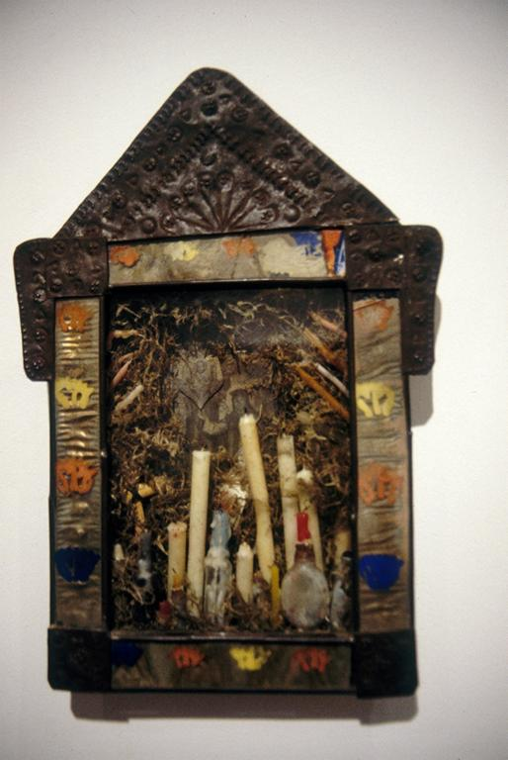
Notes:
Creator: Betye Saar Title: Garden Reliquary Work Type: Paintings Date: 1989 Location: Exhibited at Andre Zarre Gallery, Fall 1992 Description: Photographer: Larry Qualls Collection: Contemporary Art (Larry Qualls Archive) Source: Image and original data provided by Larry Qualls Rights: Please note that if this image is under copyright, you may need to contact one or more copyright owners for any use that is not permitted under the ARTstor Terms and Conditions of Use or not otherwise permitted by law. While ARTstor tries to update contact information, it cannot guarantee that such information is always accurate. Determining whether those permissions are necessary, and obtaining such permissions, is your sole responsibility.

Slide 28
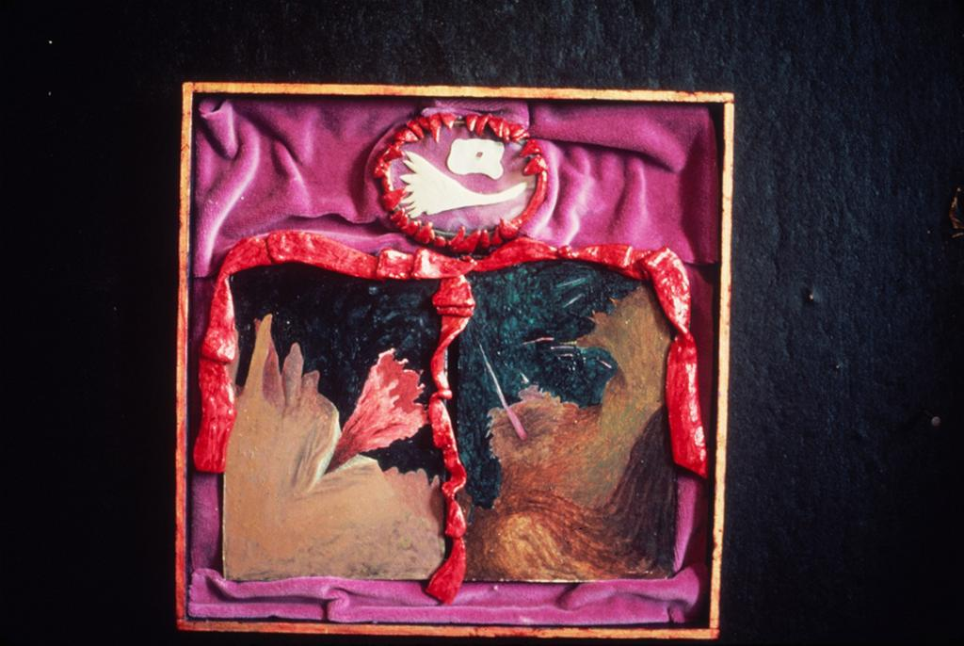
Notes:
Creator: Shelley Hull Title: Exhibition: On View: John Hernandez, Shelly Hull, Robin Winters, Krzysztof Wodiczko Title: Reliquary Work Type: Painting Date: Exhibition: 12/8/1984 Date: Work: 1984 Material: Shell, Polyform, glass, velvet, oil on pressed wood Measurements: 14.5 x 14 inches Description: Photographer: New Museum of Contemporary Art Collection: New Museum of Contemporary Art Exhibitions ID Number: 12436 Source: Image and original data from New Museum of Contemporary Art Source: http://www.newmuseum.org/ Rights: Image © New Museum of Contemporary Art (http://www.newmuseum.org) Rights: Please note that if this image is under copyright, you may need to contact one or more copyright owners for any use that is not permitted under the ARTstor Terms and Conditions of Use or not otherwise permitted by law. While ARTstor tries to update contact information, it cannot guarantee that such information is always accurate. Determining whether those permissions are necessary, and obtaining such permissions, is your sole responsibility.

Slide 29
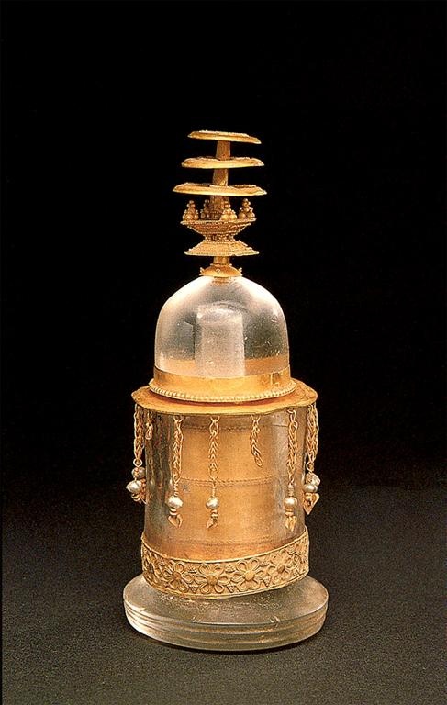
Notes:
Title: reliquary Title: reliquary Date: late 1st - 3rd century Location: Pakistan Location: North West Frontier Location: Swat Material: crystal Material: with gold Measurements: 5.31496063 in. high Style Period: Kusana Description: overview Repository: Private Collection Collection: The John C. and Susan L. Huntington Archive of Buddhist and Related Art Source: Data From: The John C. and Susan L. Huntington Archive of Buddhist and Related Art, The Ohio State University

Slide 30
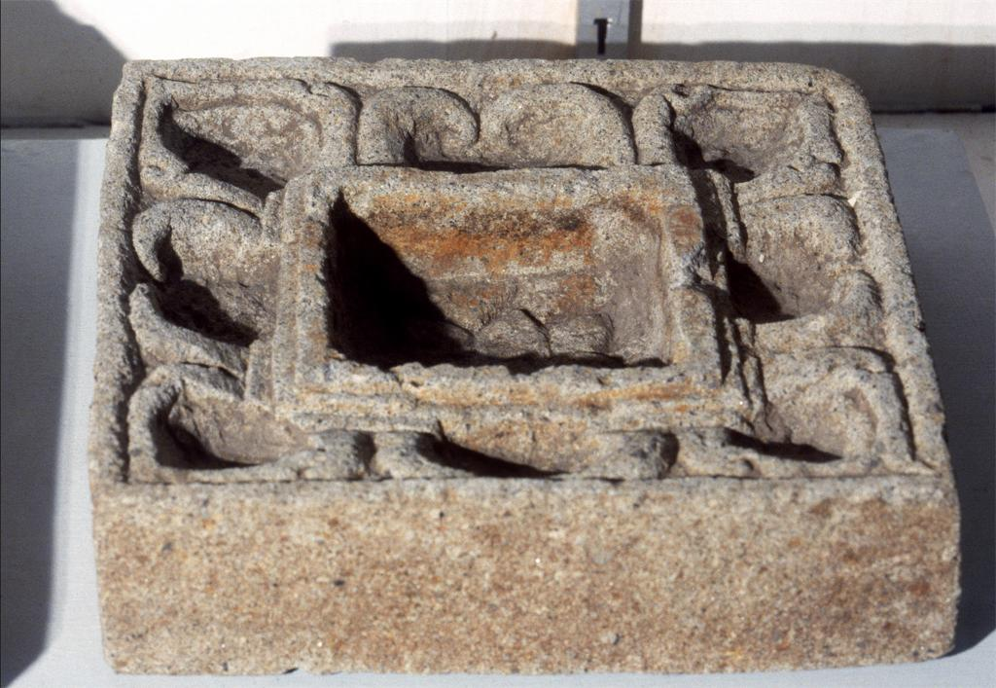
Notes:
Title: reliquary square Title: reliquary square Location: Indonesia Location: Jawa Tengah Location: Jawa Material: clay Measurements: 4 in. wide Measurements: 4 in. long Description: overview Repository: Museum Sonobudoyo, Jogjakarta, Indonesia Collection: The John C. and Susan L. Huntington Archive of Buddhist and Related Art Source: Data From: The John C. and Susan L. Huntington Archive of Buddhist and Related Art, The Ohio State University

Slide 31
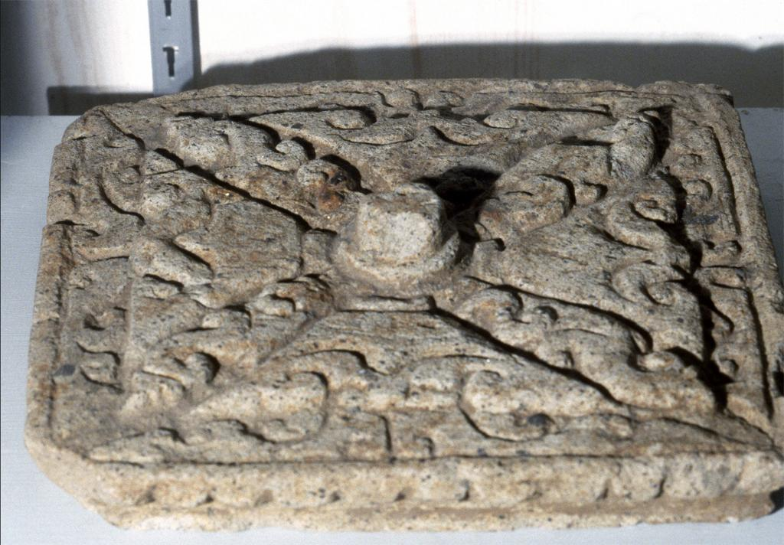
Notes:
Title: reliquary square top Title: reliquary square top Location: Indonesia Location: Jawa Tengah Location: Jawa Material: clay Measurements: 4 in. wide Measurements: 4 in. long Description: overview Repository: Museum Sonobudoyo, Jogjakarta, Indonesia Collection: The John C. and Susan L. Huntington Archive of Buddhist and Related Art Source: Data From: The John C. and Susan L. Huntington Archive of Buddhist and Related Art, The Ohio State University

Slide 32
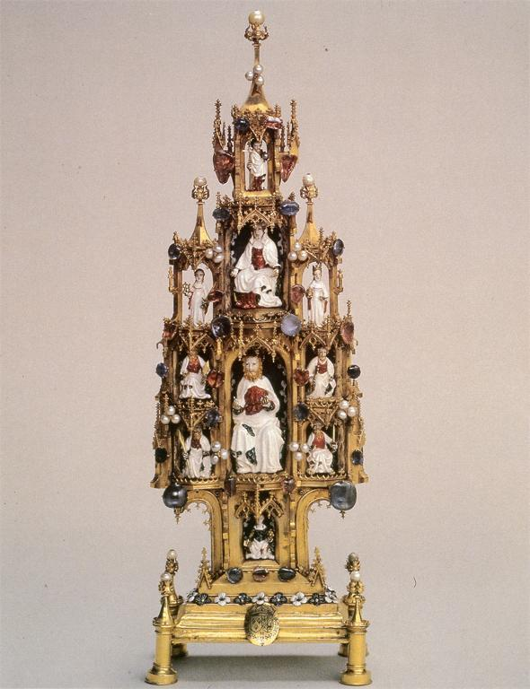
Notes:
Title: Reliquary of the Order of Saint-Espirt Date: 1410 Repository: Musée du Louvre Subject: Jeanne d'Evreux, Queen, consort of Charles IV, King of France, d. 1371 Subject: Jesus Christ Subject: Mary, Blessed Virgin, Saint Subject: Mary, Blessed Virgin, Saint--And Child Subject: Sculpture--France--15th C. A.D Collection: ARTstor Slide Gallery Source: Data from: University of California, San Diego

Slide 33
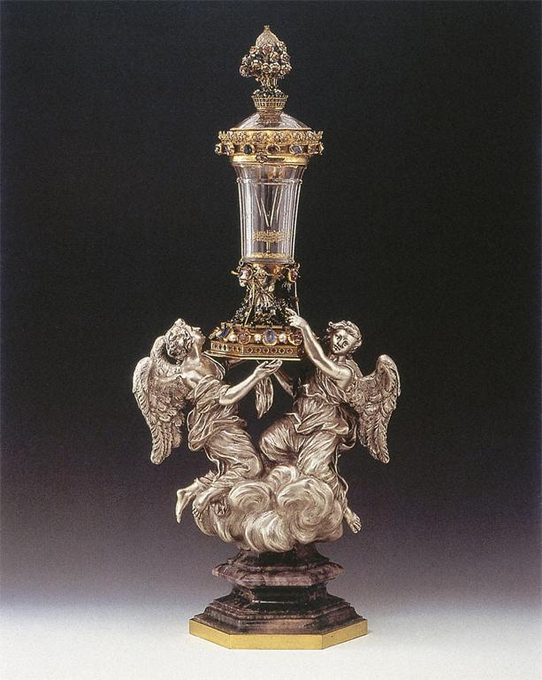
Notes:
Title: Reliquary of the Thorn Date: first half of 15th century Location: Italy Material: rock crystal with mounts of enameled gold, precious stones, and pearls Material: baroque support in silver and amethyst Description: From the Medici Collection 1400 - 1700 Repository: San Lorenzo (Church : Florence, Italy) Subject: Medici, House of Subject: Quartz crystal--Italy--15th C. A.D Subject: Angels Subject: Precious stones Subject: Reliquaries--Italy Subject: Metalwork Subject: Silver Collection: ARTstor Slide Gallery Source: Data From: University of California, San Diego

Slide 34
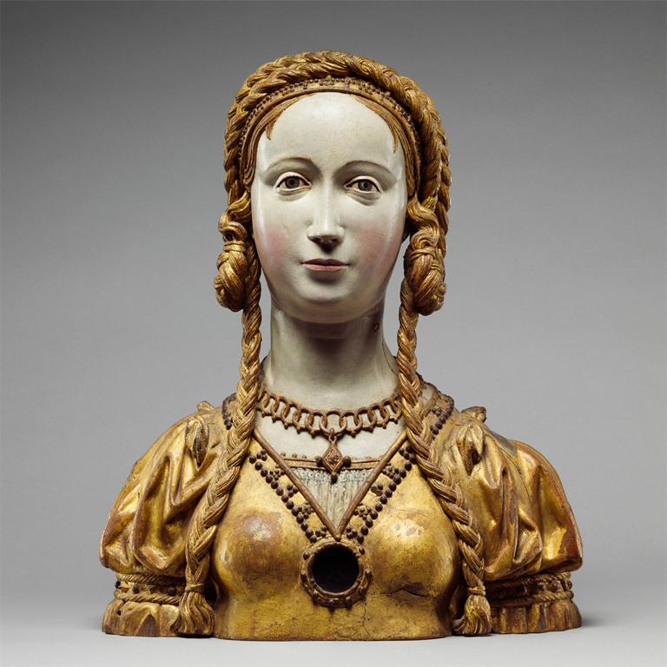
Notes:
Culture: South Lowlands, Brussels (?) Title: Reliquary Bust of a Companion of Saint Ursula Work Type: RELIQUARY BUST Date: 16th century (ca. 1520-30) Location: Formerly considered made in: Spain; Made in: Netherlands (Southern); Possibly made in: Belgium, Brabant, Brussels Material: Oak, polychromed and gilt on plaster ground; glass opening for relic Measurements: H. 17-7/8 in. (45.4 cm.) Repository: The Metropolitan Museum of Art Repository: http://www.metmuseum.org Collection: Metropolitan Museum of Art - Images for Academic Publishing ID Number: 8321 Source: Data From: The Metropolitan Museum of Art Credit Line: The Metropolitan Museum of Art, Gift of J. Pierpont Morgan, 1917 (17.190.728) Image Copyright Notice: Image © The Metropolitan Museum of Art Rights: This image was provided by The Metropolitan Museum of Art. Contact information: Image Library, The Metropolitan Museum of Art, 1000 Fifth Avenue, New York, NY 10028, (212) 396-5050 (fax), Scholars.License@MetMuseum.org Rights: Image © The Metropolitan Museum of Art Rights: This image is available for uses permitted under the ARTstor Terms and Conditions of Use, such as teaching and study, as well as for scholarly publications, through the Images for Academic Publishing (IAP) initiative. If you are seeking to use this image for scholarly publication, you should click on the IAP icon below the thumbnail image.

Slide 35
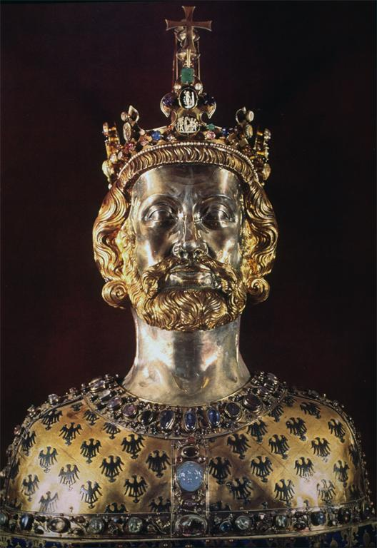
Notes:
Culture: German, Gothic Title: Reliquary bust of Charlemagne, ca. 1350 Location: Domschatz (Cathedral Treasury), Aachen, Germany Material: gilt bronze, gems, enamel Collection: Art History Survey Collection Source: Data From: Art Images for College Teaching Rights: Please note that if this image is under copyright, you may need to contact one or more copyright owners for any use that is not permitted under the ARTstor Terms and Conditions of Use or not otherwise permitted by law. While ARTstor tries to update contact information, it cannot guarantee that such information is always accurate. Determining whether those permissions are necessary, and obtaining such permissions, is your sole responsibility.

Slide 36
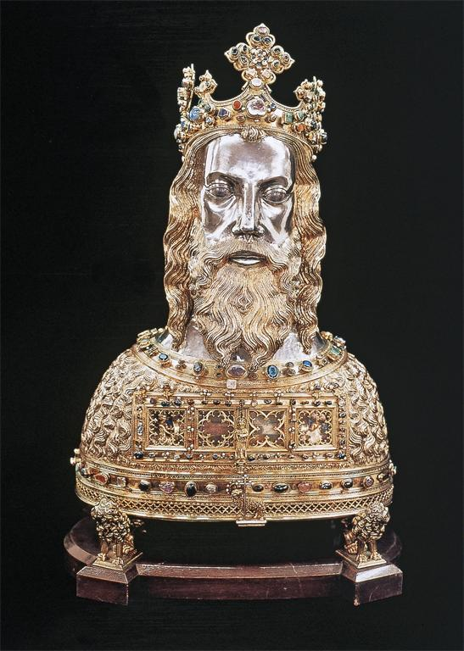
Notes:
Title: Reliquary Bust for the Arm of Saint John the Baptist Date: after 1355 Location: Germany Material: gilded silver, silver, precious stones, cameos, intaglios, pearls, rock crystal Measurements: 77 cm (height) Description: From Aachen Repository: Parish Church of St. John Baptist (Aachen, Germany) Subject: John, the Baptist, Saint Subject: Metalwork--Germany--14th C. A.D Subject: Holy Roman Empire--1273-1517 Subject: Reliquaries--Germany Subject: Saints Subject: Busts Subject: Crowns Collection: ARTstor Slide Gallery Source: Data From: University of California, San Diego

Slide 37
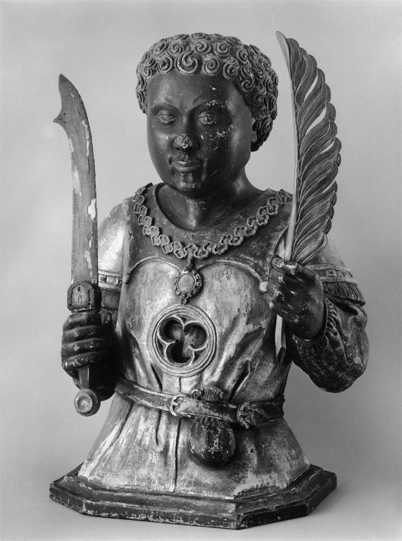
Notes:
Creator: ANONYMOUS / GERMANY (early XVI century), artist Title: Reliquary bust of a young black saint with tightly curled hair holding a short sword and a quill, representing either St. Maurice or St. Gregory the Moor. Work Type: Isolated Ronde-Bosse / Wood - Heads and Busts Date: Ca. 1500. Material: Polychromed, gilded wood. Measurements: Height: 63 cm. (24 13/16 in.). Description: Photo source: Menil Foundation, Houston (TX) Description: Photographer: Hickey & Robertson Description: Photo source: Rheinisches Bildarchiv, Cologne Related Item: Gude SUCKALE-REDLEFSEN and Robert SUCKALE. Mauritius: Der heilige Mohr / The Black Saint Maurice (Houston, Munich, and Zurich, 1986), p. 276, no. G7. Subject: Saints, Maurice of Agaunum Subject: Saints, Gregory the Moor Collection: Image of the Black in Western Art (Harvard University) ID Number: 16924 Source: Data from: The Image of the Black in Western Art Research Project and Photo Archive, W.E.B. Du Bois Institute for African and African American Research, Harvard University Rights: For permissions information, please contact: The Image of the Black in Western Art Project and Photo Archive W.E.B. Du Bois Institute, 104 Mt. Auburn St., 3R, Cambridge, MA 02138, Tel.: 617 495-1875, Fax: 617 495-8511, e-mail: scheek@fas.harvard.edu, kcdalton@fas.harvard.edu, BlackImage@harvard.edu, web site: http://www.dubois.fas.harvard.edu Rights: Please note that if this image is under copyright, you may need to contact one or more copyright owners for any use that is not permitted under the ARTstor Terms and Conditions of Use or not otherwise permitted by law. While ARTstor tries to update contact information, it cannot guarantee that such information is always accurate. Determining whether those permissions are necessary, and obtaining such permissions, is your sole responsibility.

Slide 38
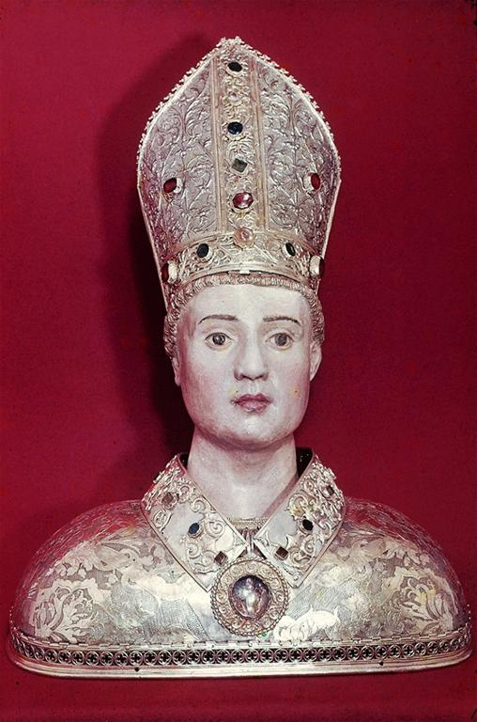
Notes:
Title: Reliquary bust of St. Lizier Date: First half of 6th C Description: Saint-Omer, Eglise Notre Dame Description: Toulouse, Treasure of the old Cathedral of St. Lizier Subject: Portrait busts Subject: Saints Subject: Sculpture--France--6th C. A.D Collection: ARTstor Slide Gallery Source: Data from: University of California, San Diego

Slide 39
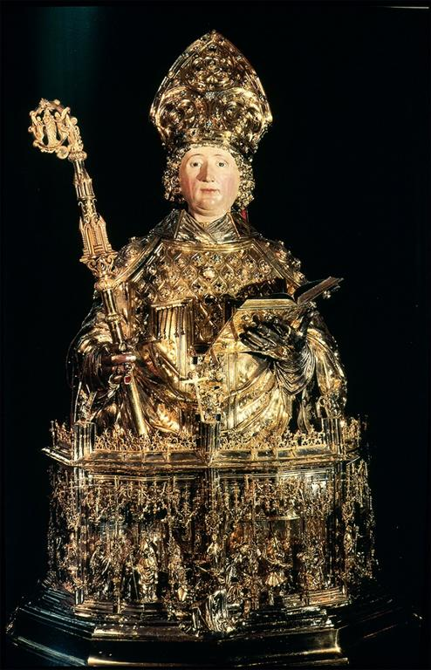
Notes:
Title: Bust Reliquary of St. Lambert Date: 1505 - 1512 Material: gilt, silver repousse, cisele Measurements: h. 1.50m Repository: Liège (Belgium). Cathedral of St. Paul Treasury Subject: Gothic Subject: Reliquaries Subject: Sculpture--France--16th C. A.D Subject: St. Lambert Collection: ARTstor Slide Gallery Source: Data from: University of California, San Diego

Slide 40
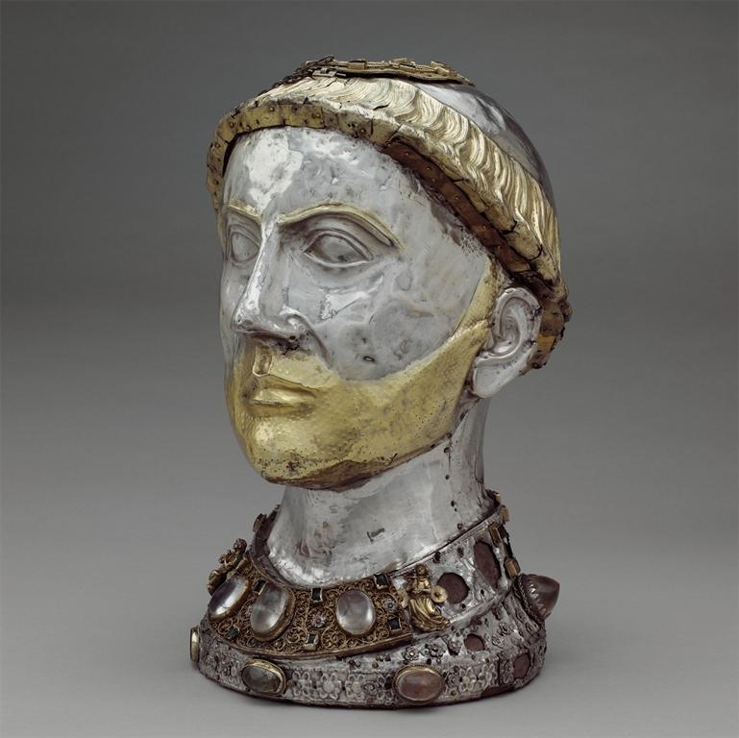
Notes:
Culture: French Title: Reliquary Head Title: 3/4 Left Date: ca. 1200-1240, with later grill Location: Made in: Limoges Material: Silver over wood, silver-gilt, cabochon stones Measurements: Overall (Reliquary): 15 x 9 3/16 x 10 1/4 in. (38.1 x 23.4 x 26.1 cm) (b)wooden core: 14 7/16 x 8 7/8 x 9 13/16 in. (36.6 x 22.5 x 24.9 cm) Repository: The Metropolitan Museum of Art Repository: http://www.metmuseum.org Collection: Metropolitan Museum of Art - Images for Academic Publishing ID Number: 4207 Source: Data From: The Metropolitan Museum of Art Credit Line: The Metropolitan Museum of Art, Gift of J. Pierpont Morgan, 1917 (17.190.352a, b) Image Copyright Notice: Image © The Metropolitan Museum of Art Rights: This image was provided by The Metropolitan Museum of Art. Contact information: Image Library, The Metropolitan Museum of Art, 1000 Fifth Avenue, New York, NY 10028, (212) 396-5050 (fax), Scholars.License@MetMuseum.org Rights: Image © The Metropolitan Museum of Art Rights: This image is available for uses permitted under the ARTstor Terms and Conditions of Use, such as teaching and study, as well as for scholarly publications, through the Images for Academic Publishing (IAP) initiative. If you are seeking to use this image for scholarly publication, you should click on the IAP icon below the thumbnail image.

Slide 41
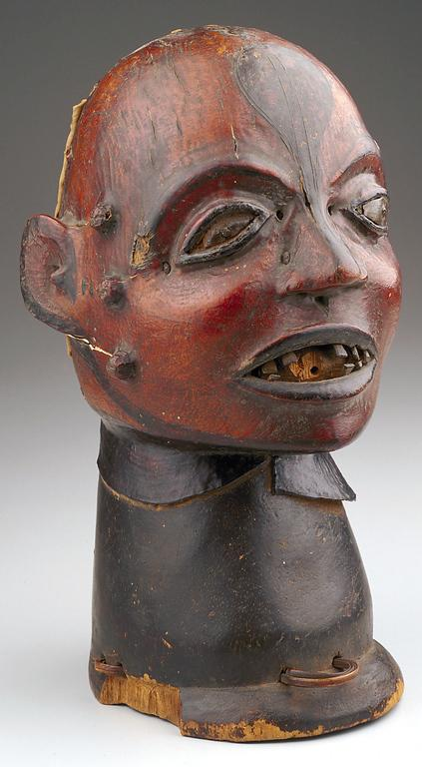
Notes:
Creator: Ejagham, African; West African; Nigerian, (artist) Title: Reliquary Head Work Type: Sculpture Date: 19th century - 20th century Location: Created in Cross River Area Material: wood, skin Measurements: H.11 x W.6-3/8 in. Description: Front Repository: The Minneapolis Institute of Arts Repository: Minneapolis, Minnesota, USA Repository: Gift of Russell Cowles Repository: 71.76 Repository: http://www.artsmia.org/ Collection: The Minneapolis Institute of Arts Collection Collection: Formerly in The AMICO Library ID Number: MIA_.71.76 Source: Data From: The Minneapolis Institute of Arts Rights: This image was provided by The Minneapolis Institute of Arts. Contact information: DeAnn Dankowski, Permissions Assistant, The Minneapolis Institute of Arts, 2400 Third Avenue South, Minneapolis, MN 55404, (612) 870-3029 (ph), (612) 870-3004 (fax), permissions@artsmia.org. Rights: Please note that if this image is under copyright, you may need to contact one or more copyright owners for any use that is not permitted under the ARTstor Terms and Conditions of Use or not otherwise permitted by law. While ARTstor tries to update contact information, it cannot guarantee that such information is always accurate. Determining whether those permissions are necessary, and obtaining such permissions, is your sole responsibility.

Slide 42
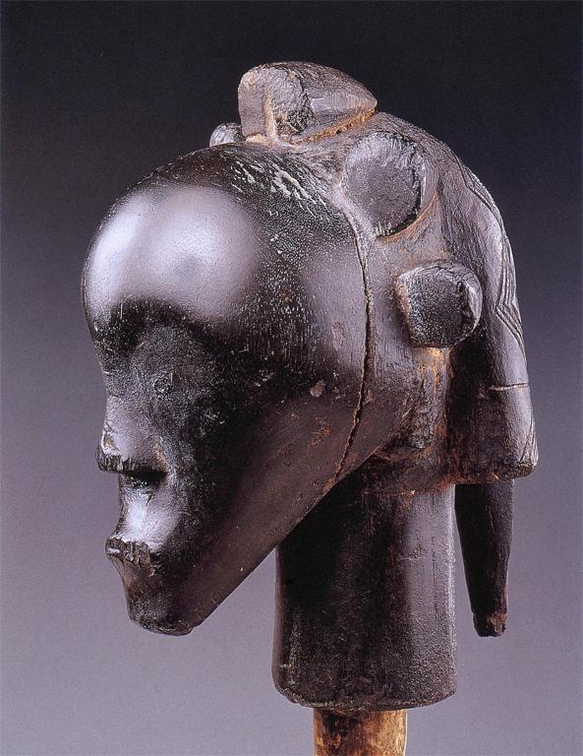
Notes:
Title: Reliquary head (nio byeri) Date: [n.d.] Material: wood, pigments Measurements: 29 cm Repository: Musée Dapper (Paris, France) Subject: Special Societal Groups--Tribal Africa: Fang Subject: Fang (West African people) Subject: Reliquary figures Subject: Hairstyles Subject: Heads Subject: Abstract Collection: ARTstor Slide Gallery Source: Data From: University of California, San Diego

Slide 43
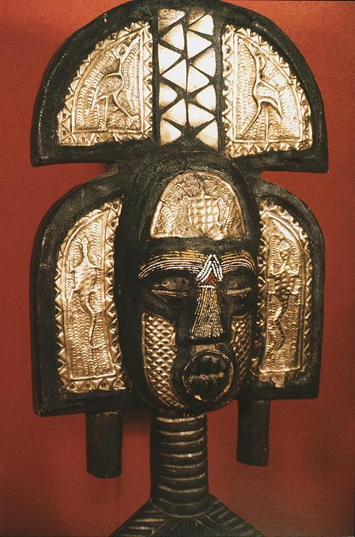
Notes:
Title: Reliquary-guardian figure: det.: head Subject: Sculpture--Kota Subject: Special Societal Groups--Tribal Africa: Kota Collection: ARTstor Slide Gallery Source: Data from: University of California, San Diego

Slide 44
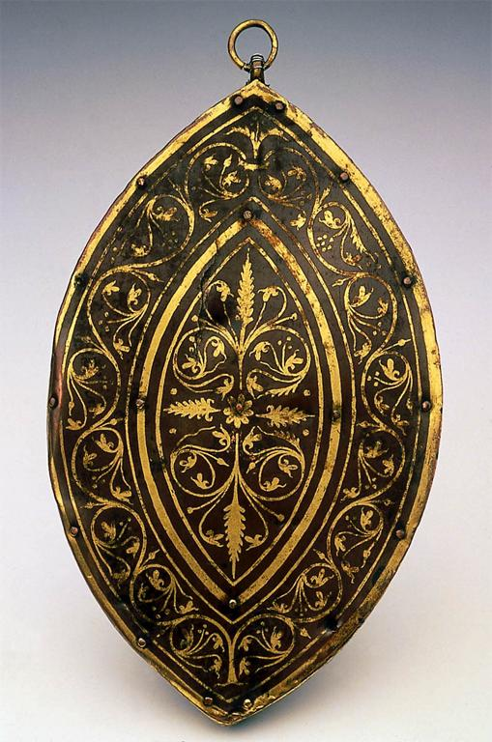
Notes:
Creator: Unidentified Creator: Artist Title: Hanging Reliquary Work Type: Decorative Arts and Utilitarian Objects Date: third quarter of the 12th century Material: Gilt copper repoussé, rock crystal, wood, bone Measurements: 16.9 x 10.6 x 3.7 cm (6 5/8 x 4 3/16 x 1 7/16 in.) Description: Germany Meuse Description: Full View Repository: Museum of Fine Arts, Boston Repository: Boston, Massachusetts, USA Repository: William Francis Warden Fund Repository: 49.480 Repository: http://www.mfa.org/ Collection: Museum of Fine Arts, Boston, Collection Collection: Formerly in The AMICO Library ID Number: BMFA.49.480 Source: Data From: Museum of Fine Arts, Boston Rights: This image was provided by Museum of Fine Arts, Boston. Contact information: Debra LaKind, Head of Rights & Licensing, Museum of Fine Arts, Boston, 465 Huntington Avenue, Boston, MA 02115, (617) 369-4386 (ph), (617) 369-4340 (fax), dlakind@mfa.org. Rights: Please note that if this image is under copyright, you may need to contact one or more copyright owners for any use that is not permitted under the ARTstor Terms and Conditions of Use or not otherwise permitted by law. While ARTstor tries to update contact information, it cannot guarantee that such information is always accurate. Determining whether those permissions are necessary, and obtaining such permissions, is your sole responsibility.

Slide 45
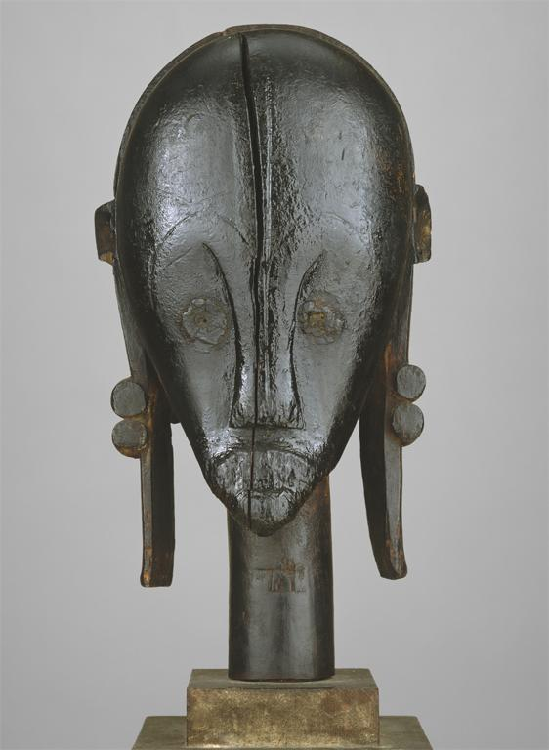
Notes:
Culture: Gabon; Fang, Betsi group Title: Reliquary Head (Nlo Bieri) Work Type: FIGURE (NLO BIERI), HEAD, RELIQUARY Date: 19th-20th century Location: Object Place: Gabon Material: Wood, metal, palm oil Measurements: H. 18 5/16 in. (46.5 cm) Style: Fang, Betsi group Repository: The Metropolitan Museum of Art Repository: http://www.metmuseum.org Collection: Metropolitan Museum of Art - Images for Academic Publishing ID Number: 5010 Source: Data From: The Metropolitan Museum of Art Credit Line: The Metropolitan Museum of Art, The Michael C. Rockefeller Memorial Collection, Bequest of Nelson A. Rockefeller, 1979 (1979.206.229) Image Copyright Notice: Image © The Metropolitan Museum of Art Rights: This image was provided by The Metropolitan Museum of Art. Contact information: Image Library, The Metropolitan Museum of Art, 1000 Fifth Avenue, New York, NY 10028, (212) 396-5050 (fax), Scholars.License@MetMuseum.org Rights: Image © The Metropolitan Museum of Art Rights: This image is available for uses permitted under the ARTstor Terms and Conditions of Use, such as teaching and study, as well as for scholarly publications, through the Images for Academic Publishing (IAP) initiative. If you are seeking to use this image for scholarly publication, you should click on the IAP icon below the thumbnail image.

Slide 46
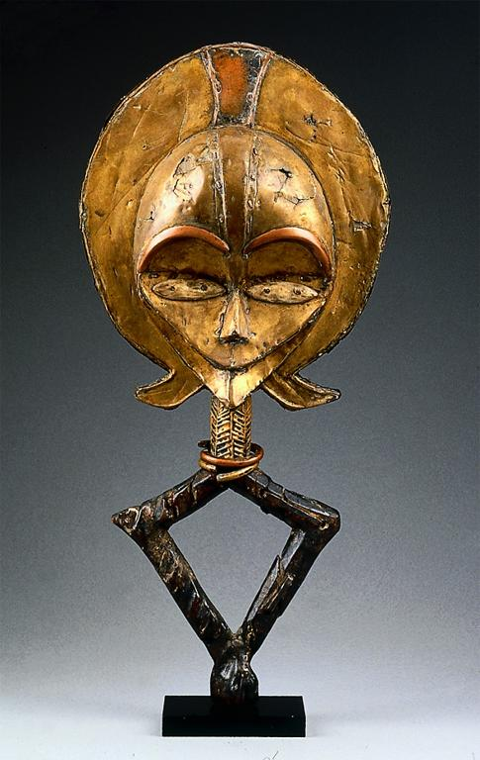
Notes:
Creator: Kota people Creator: Gabon Culture: African; Central African; Gabonese Title: Reliquary guardian figure (mbulu ngulu) Work Type: Sculpture Date: 19th-20th century Material: Wood, copper, brass, bone Measurements: 25 x 11 x 5 in. Description: View: Recto Repository: Museum of Fine Arts, Boston Repository: Boston, Massachusetts, USA Repository: Lent by William E. Teel Repository: E9561 Repository: http://www.mfa.org/ Collection: Museum of Fine Arts, Boston, Collection Collection: Formerly in The AMICO Library ID Number: BMFA.E9561 Source: Data From: Museum of Fine Arts, Boston Rights: This image was provided by Museum of Fine Arts, Boston. Contact information: Debra LaKind, Head of Rights & Licensing, Museum of Fine Arts, Boston, 465 Huntington Avenue, Boston, MA 02115, (617) 369-4386 (ph), (617) 369-4340 (fax), dlakind@mfa.org. Rights: Please note that if this image is under copyright, you may need to contact one or more copyright owners for any use that is not permitted under the ARTstor Terms and Conditions of Use or not otherwise permitted by law. While ARTstor tries to update contact information, it cannot guarantee that such information is always accurate. Determining whether those permissions are necessary, and obtaining such permissions, is your sole responsibility.

Slide 47
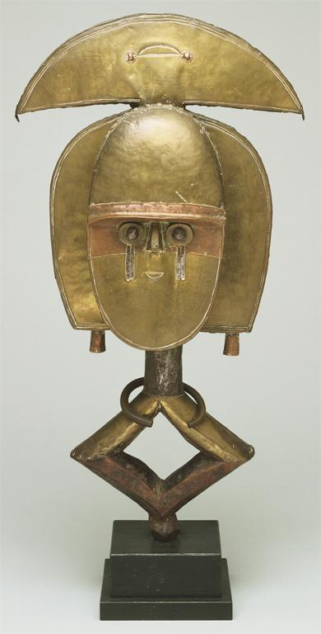
Notes:
Creator: Artist/maker unknown, African Title: Reliquary Guardian Figure, Mbulu Ngulu Work Type: Sculpture Date: Early 20th century Material: Iron, brass, and copper over wood Measurements: 22 x 12 x 3 1/2 inches (55.9 x 30.5 x 8.9 cm) Description: Full View Repository: Philadelphia Museum of Art Repository: Philadelphia, Pennsylvania, USA Repository: Gift of the Estate of John F. Harbeson, 1988 Repository: 1988-115-1 Repository: http://www.philamuseum.org/main.asp Collection: Philadelphia Museum of Art Collection Collection: Formerly in The AMICO Library ID Number: PMA_.1988-115-1 Source: Data From: Philadelphia Museum of Art Rights: This image was provided by Philadelphia Museum of Art. Contact information: Ms. Conna Clark, Manager, Rights & Reproductions, Philadelphia Museum of Art, P.O. Box 7646, Philadelphia, PA 19101, (215) 684-7901 (ph), (215) 235-0034 (fax), cclark@philamuseum.org. Rights: Please note that if this image is under copyright, you may need to contact one or more copyright owners for any use that is not permitted under the ARTstor Terms and Conditions of Use or not otherwise permitted by law. While ARTstor tries to update contact information, it cannot guarantee that such information is always accurate. Determining whether those permissions are necessary, and obtaining such permissions, is your sole responsibility.

Slide 48
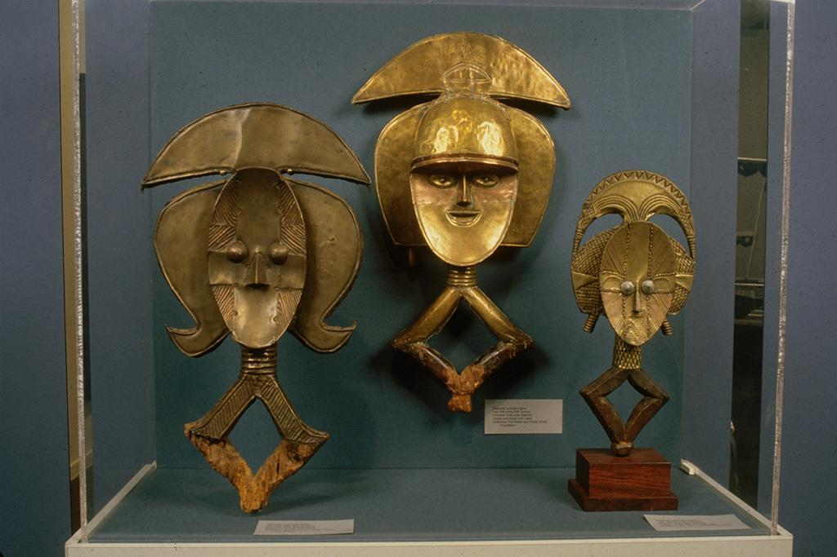
Notes:
Creator: Unknown (Gabon) Title: Exhibition: Africa Explores: 20th Century African Art Title: Reliquary Guardian Figures Work Type: Traditional Date: Exhibition: 5/11/1991-9/18/1991 Date: Work: late 19th , early 20th century Description: Photographer: Fred Scrutin Collection: New Museum of Contemporary Art Exhibitions ID Number: 14418 Source: Image and original data from New Museum of Contemporary Art Source: http://www.newmuseum.org/ Rights: Image © New Museum of Contemporary Art (http://www.newmuseum.org) Rights: Please note that if this image is under copyright, you may need to contact one or more copyright owners for any use that is not permitted under the ARTstor Terms and Conditions of Use or not otherwise permitted by law. While ARTstor tries to update contact information, it cannot guarantee that such information is always accurate. Determining whether those permissions are necessary, and obtaining such permissions, is your sole responsibility.

Slide 49
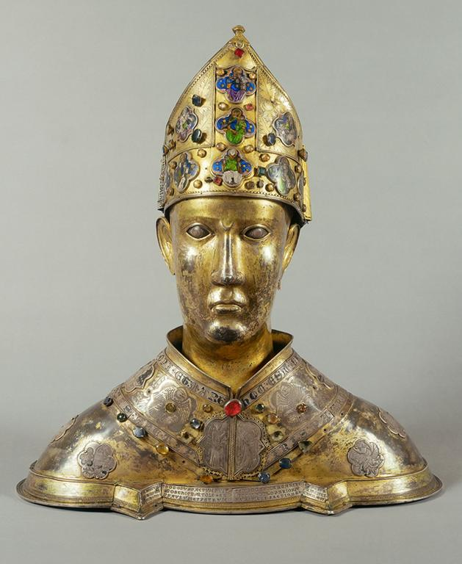
Notes:
Culture: Gothic Title: Head of Saint Donatus Work Type: reliquary Repository: Parrocchia Santa Maria Delle Grazie (Arezzo, Italy) Collection: Italian and other European Art (Scala Archives) Source: Image and original data provided by SCALA, Florence/ART RESOURCE, N.Y. Source: http://www.artres.com/c/htm/Home.aspx Source: http://www.scalarchives.com Rights: (c) 2006, SCALA, Florence / ART RESOURCE, N.Y. Rights: Please note that if this image is under copyright, you may need to contact one or more copyright owners for any use that is not permitted under the ARTstor Terms and Conditions of Use or not otherwise permitted by law. While ARTstor tries to update contact information, it cannot guarantee that such information is always accurate. Determining whether those permissions are necessary, and obtaining such permissions, is your sole responsibility.

Slide 50
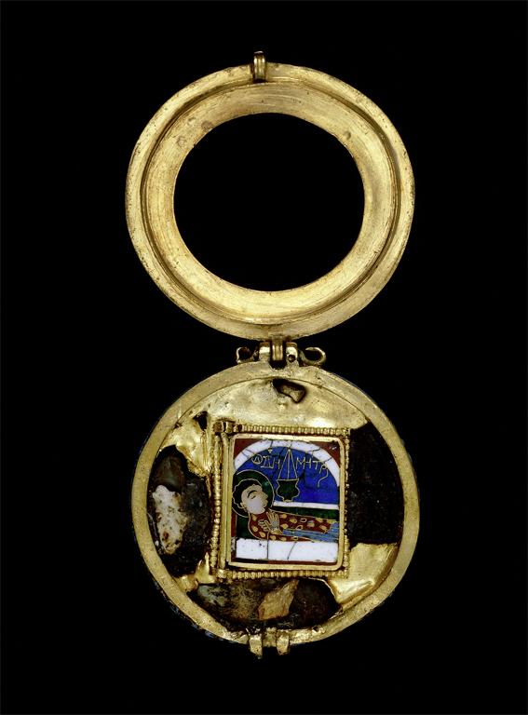
Notes:
Culture: Byzantine Title: Reliquary Pendant with Saint Demetrius, open position Work Type: personal ornament Date: 13th century Material: gold and enamel Measurements: 37.5 cm diameter Description: from Thessaloniki, Greece Repository: British Museum, London, United Kingdom Collection: Art, Archaeology and Architecture (Erich Lessing Culture and Fine Arts Archives) ID Number: 30-01-08/69 Source: Image and original data provided by Erich Lessing Culture and Fine Arts Archives/ART RESOURCE, N.Y. Source: http://www.artres.com/c/htm/Home.aspx Source: http://www.artres.com/c/htm/TreePfLight.aspx?ID=LES Rights: Photo Credit: Erich Lessing/ART RESOURCE, N.Y. Rights: Please note that if this image is under copyright, you may need to contact one or more copyright owners for any use that is not permitted under the ARTstor Terms and Conditions of Use or not otherwise permitted by law. While ARTstor tries to update contact information, it cannot guarantee that such information is always accurate. Determining whether those permissions are necessary, and obtaining such permissions, is your sole responsibility.

Slide 51
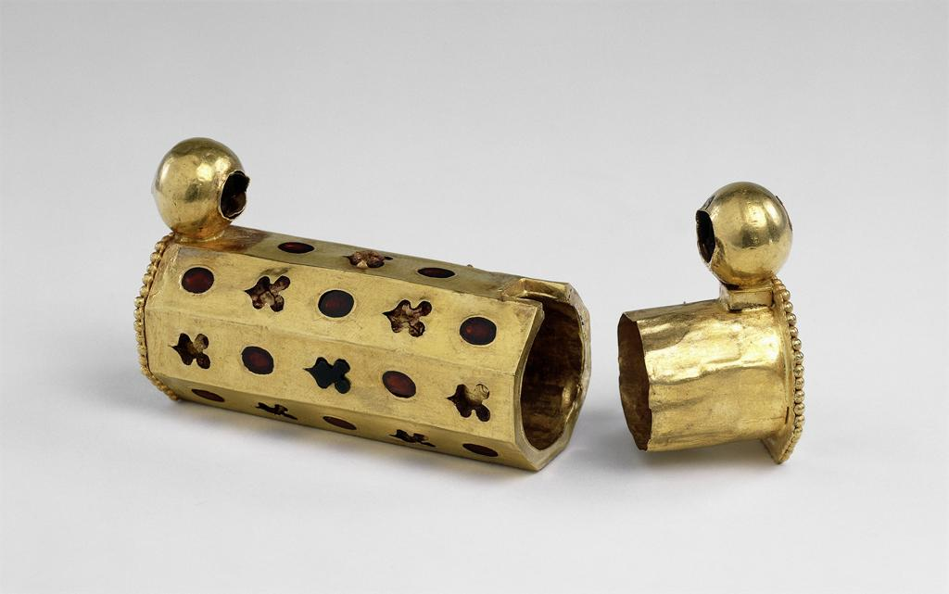
Notes:
Culture: Indian Title: Reliquary Amulet Work Type: personal ornament Date: 2nd century CE Material: gold studded with garnets Measurements: 7.5 cm Style Period: Gandharan Description: found at the Ahin Posh Stupa in Jalalabad, Afghanistan Repository: British Museum, London, United Kingdom Collection: Art, Archaeology and Architecture (Erich Lessing Culture and Fine Arts Archives) ID Number: 03-07-01/59 Source: Image and original data provided by Erich Lessing Culture and Fine Arts Archives/ART RESOURCE, N.Y. Source: http://www.artres.com/c/htm/Home.aspx Source: http://www.artres.com/c/htm/TreePfLight.aspx?ID=LES Rights: Photo Credit: Erich Lessing/ART RESOURCE, N.Y. Rights: Please note that if this image is under copyright, you may need to contact one or more copyright owners for any use that is not permitted under the ARTstor Terms and Conditions of Use or not otherwise permitted by law. While ARTstor tries to update contact information, it cannot guarantee that such information is always accurate. Determining whether those permissions are necessary, and obtaining such permissions, is your sole responsibility.

Slide 52
Notes:
Title: Gold and Enamel Pendent Reliquary Date: 13th C Material: gold, enamel Measurements: d.37.5mm Subject: George, Saint, d. 303 Subject: Jewelry--Byzantine Subject: Metalwork--Byzantine--13th C. A.D Subject: Pendants (jewelry) Subject: Saints Subject: cloisonne Collection: ARTstor Slide Gallery Source: Data from: University of California, San Diego

Slide 53
Notes:
Creator: Artist: Anonymous (Greek) Culture: Orthodox Title: Reliquary Pendant with Virgin and Child Work Type: reliquaries;pendants Dynasty: Ottoman Dynasty Period: Post-Byzantine Date: 16th century Location: Place of Origin: Constantinople (present-day Istanbul, Turkey) Material: gold, amethyst, emeralds, rubies, pearls, semiprecious stones, niello Measurements: 2 9/16 x 2 7/16 in. (6.51 x 6.19 cm) Description: This exceptional pendant consists of a reliquary cross inside a hinged case with six small adjacent compartments for relics (see also Walters 57.1511B and 57.1511C). The impressive amethyst cameo depicting the Virgin and Child on the lid is surrounded by cabochon rubies and emeralds alternating with pearls. The cross and the outer edge of the case are adorned with additional pearls, and the back of the case is decorated in a similar fashion, omitting the central cameo. A ground of dense filigree covers the front and back of the case, while the inside as well as the inscription and the Crucifixion scene on the cross are done in niello. The text identifies the donor, location, and the time when the piece was crafted, which is rare in Post-Byzantine jewelry: the cross was dedicated by the Metropolitan Arsenios of Serres, a town in northern Greece, to the monastery of St. John on the island of Chalke near Constantinople in the middle of the 16th century. Repository: The Walters Art Museum Repository: Acquired by Henry Walters Repository: 57.1511A Repository: Henry Walters, Baltimore [date and mode of acquisition unknown]; Walters Art Museum, 1931, by bequest. Repository: http://thewalters.org Collection: The Walters Art Museum Rights: For information on reproductions for publishing or commercial use, Contact Photographic Services at 410-547-9000 ext. 254 or email photoservices@thewalters.org. Rights: Please note that if this image is under copyright, you may need to contact one or more copyright owners for any use that is not permitted under the ARTstor Terms and Conditions of Use or not otherwise permitted by law. While ARTstor tries to update contact information, it cannot guarantee that such information is always accurate. Determining whether those permissions are necessary, and obtaining such permissions, is your sole responsibility.

